Slide 1

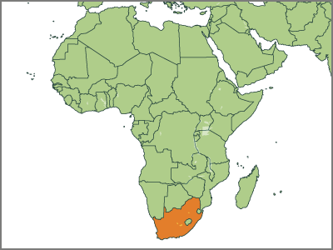

South Africa
Reality bites:
The long road to recovery
Nicky Weimar
September 2018

Slide 2
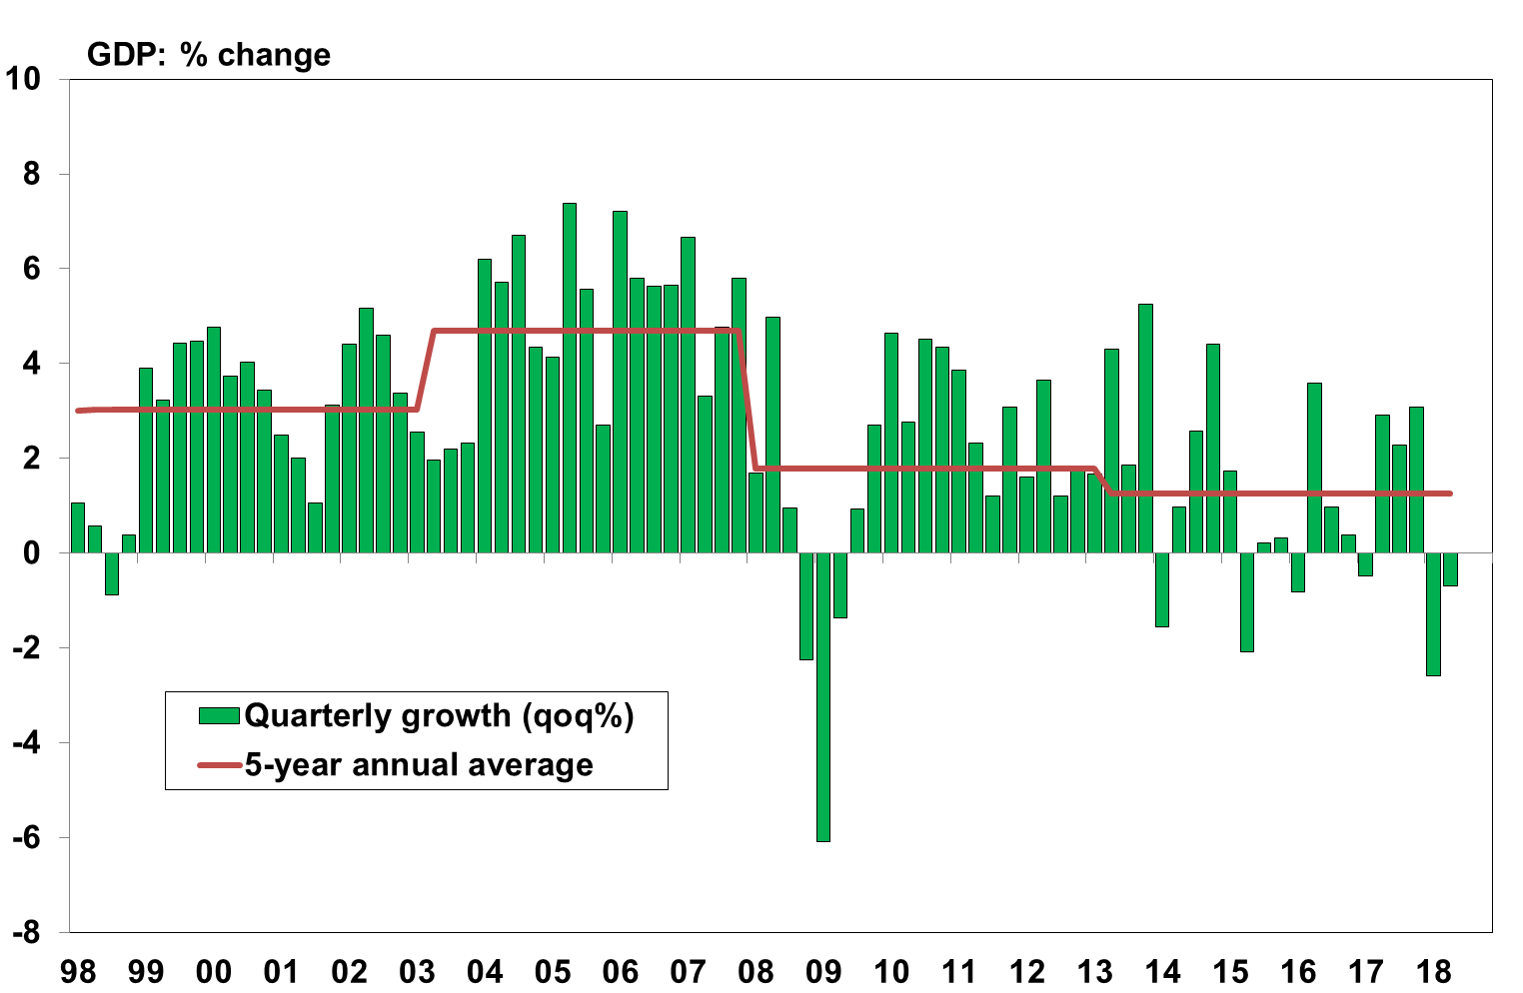
Economic conditions deteriorated in H1 2018
The economy was stuck in recession

Slide 3
At the least the rate of decline moderated over the second quarter, but the weakness was still widespread
Sources: NGEU

Slide 4
Most sources of demand also faltered during the first half of the year
Sources: NGEU

Slide 5
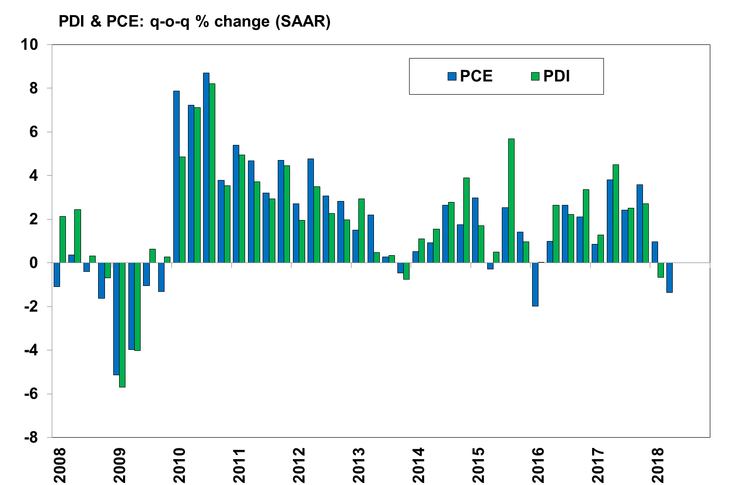
Household income contracted in Q1 and this decline more than
likely continued in Q2, forcing households to cut back on spending
Sources: SARB

Slide 6
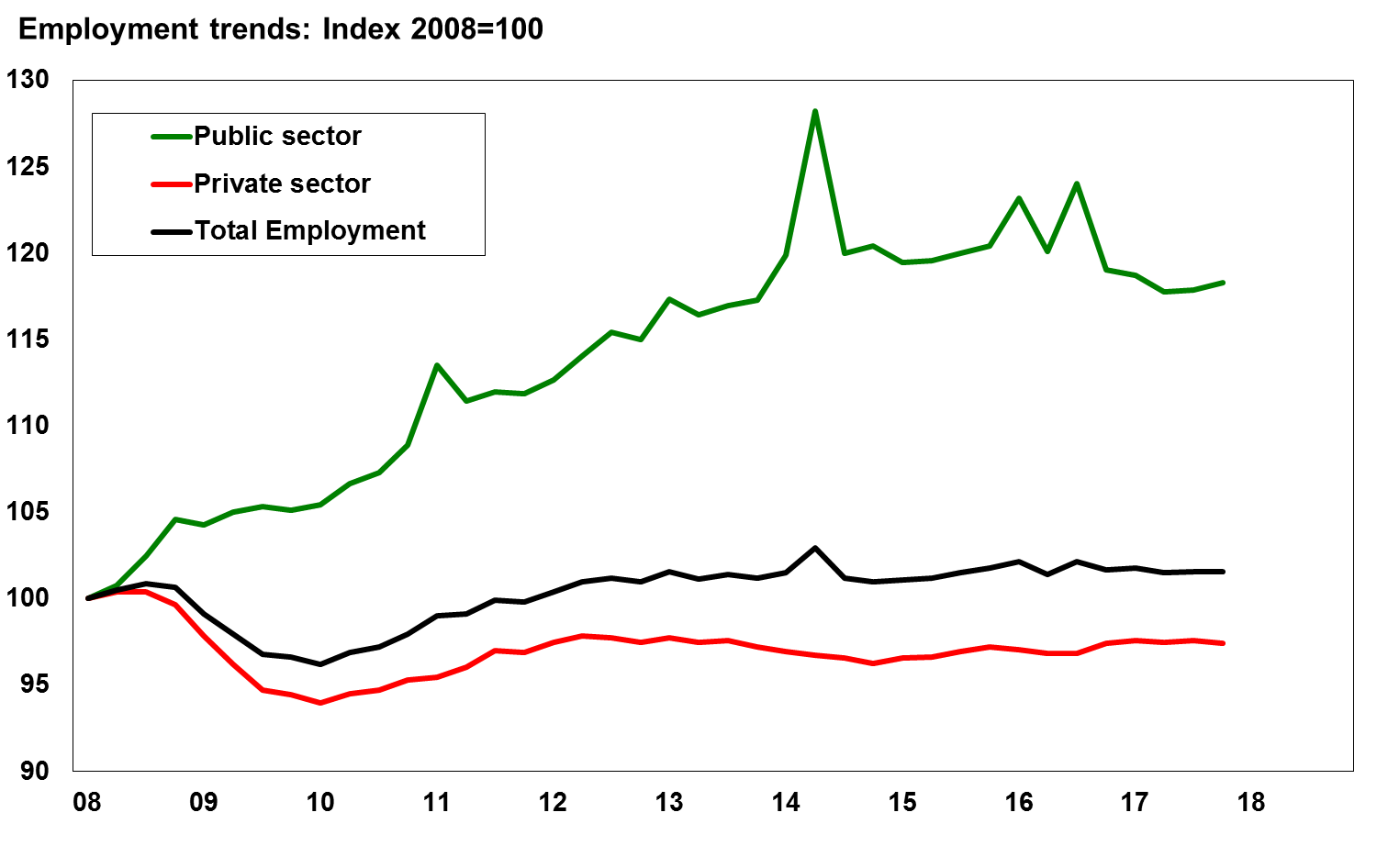
During the past 10 years the boost to household income has come mainly
from public sector employment
Sources: SARB

Slide 7
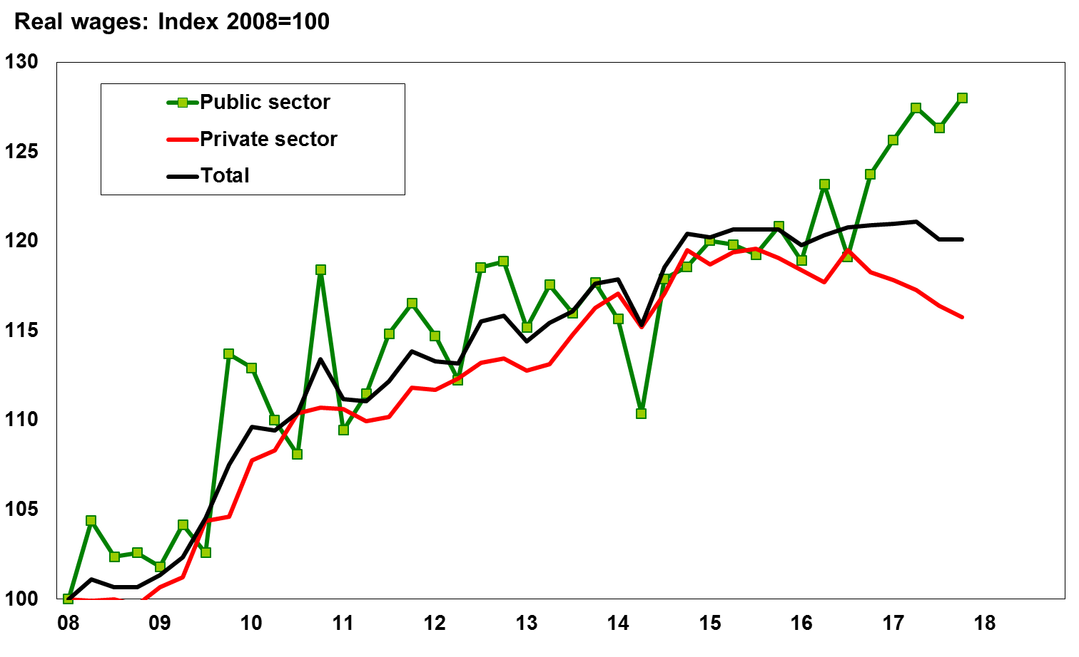
…and public sector pay.
Unfortunately, the surge in the public sector wage bill was not sustainable
Sources: SARB

Slide 8
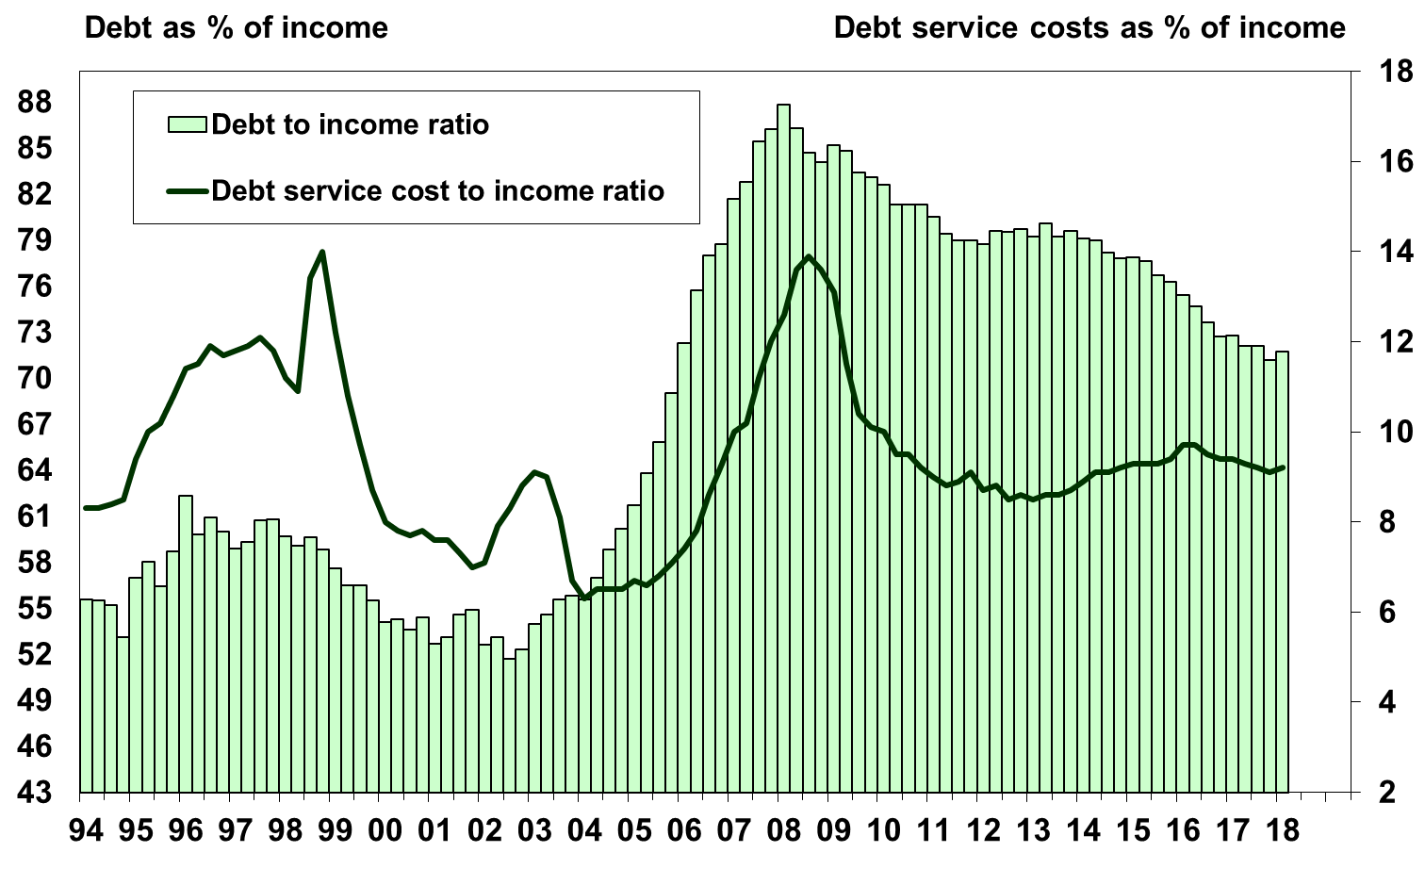
Household debt burdens are much lower
Sources: SARB

Slide 9
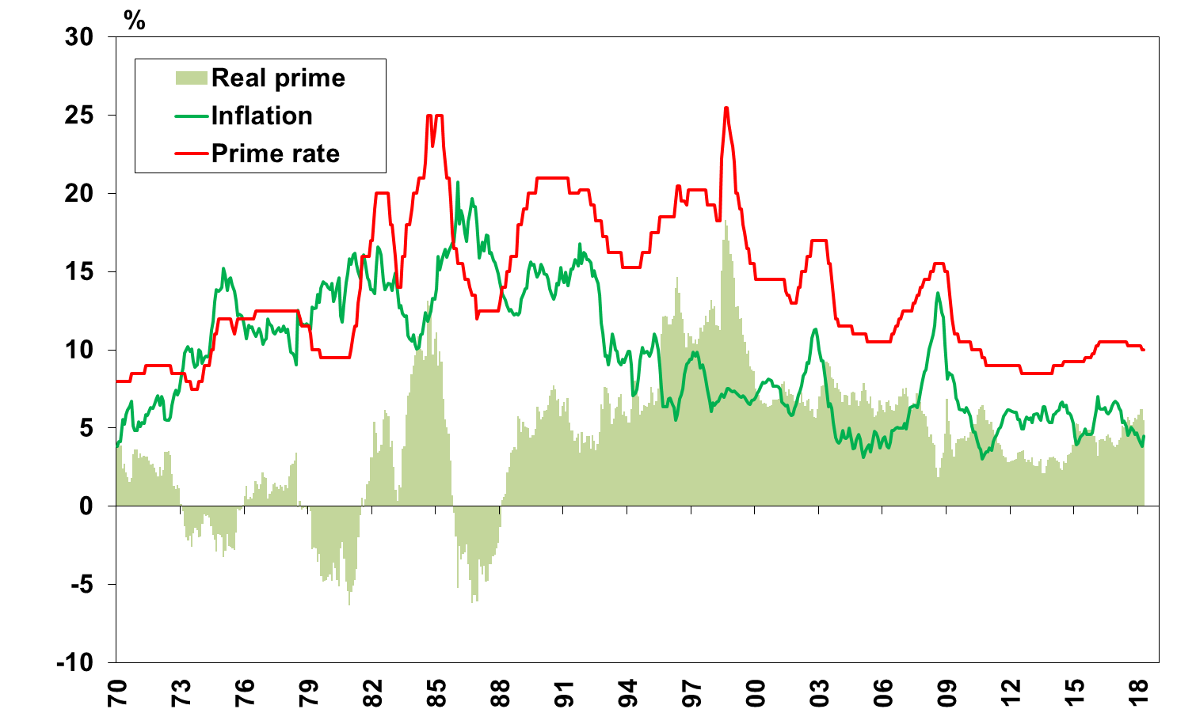
Interest rates are at least 50 basis points lower since July last year
Source: Thompson Reuters
Nedbank Group Economic Unit

Slide 10
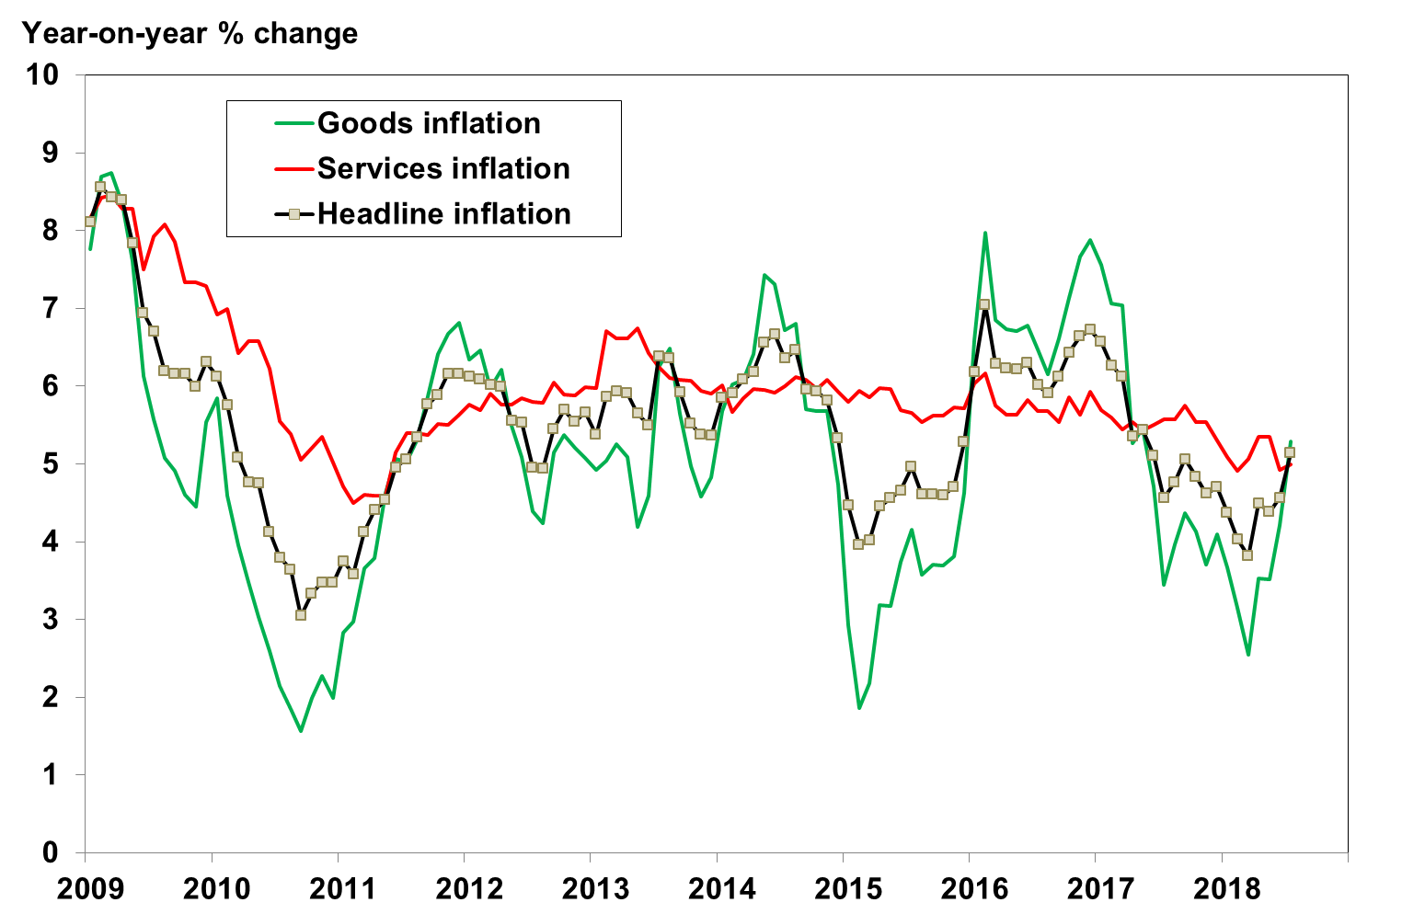
Much depends on the inflation outlook
Inflation has moved higher, driven by hikes in indirect taxes
Sources: Stats SA

Slide 11
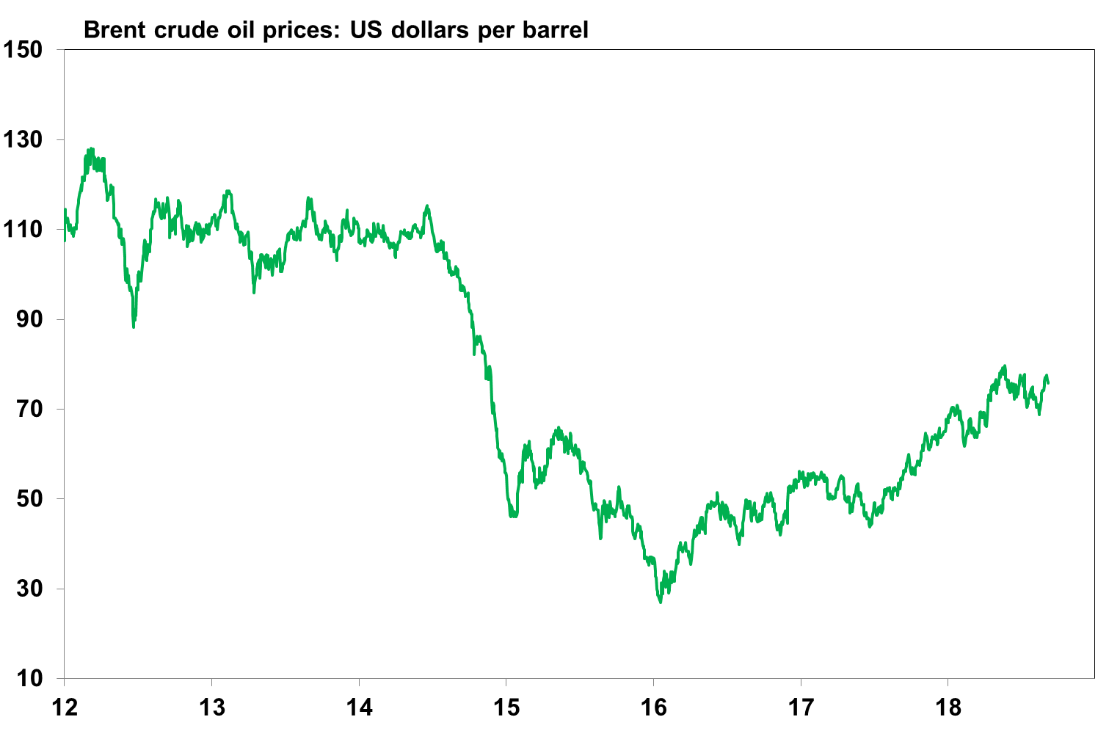
Oil prices are also moving higher, aggravated by geopolitical concerns
Sources: Thompson Reuters

Slide 12
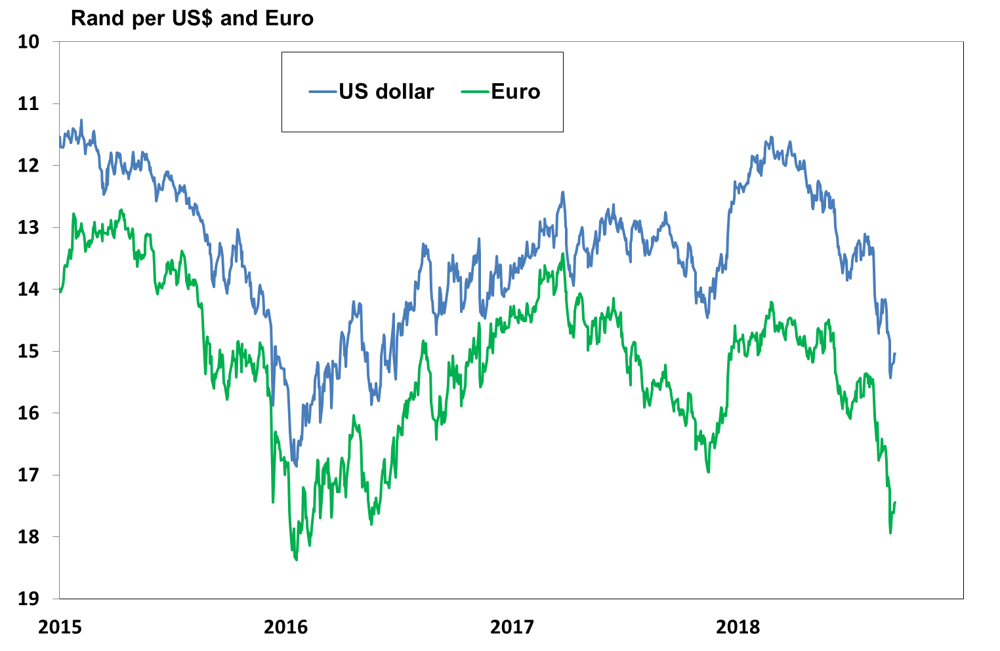
The rand has come under significant pressure since April, depreciating
sharply in August and early September
Source: Thompson Reuters
Nedbank Group Economic Unit

Slide 13
  Factors driving the rand weaker
A decline in general risk appetite among global investors, triggered mainly by:
The gradual rise in US interest rates and the expectation of the normalisation of monetary policy in most advanced countries have encouraged capital to move back to the US and other low-risk developed countries.

Slide 14
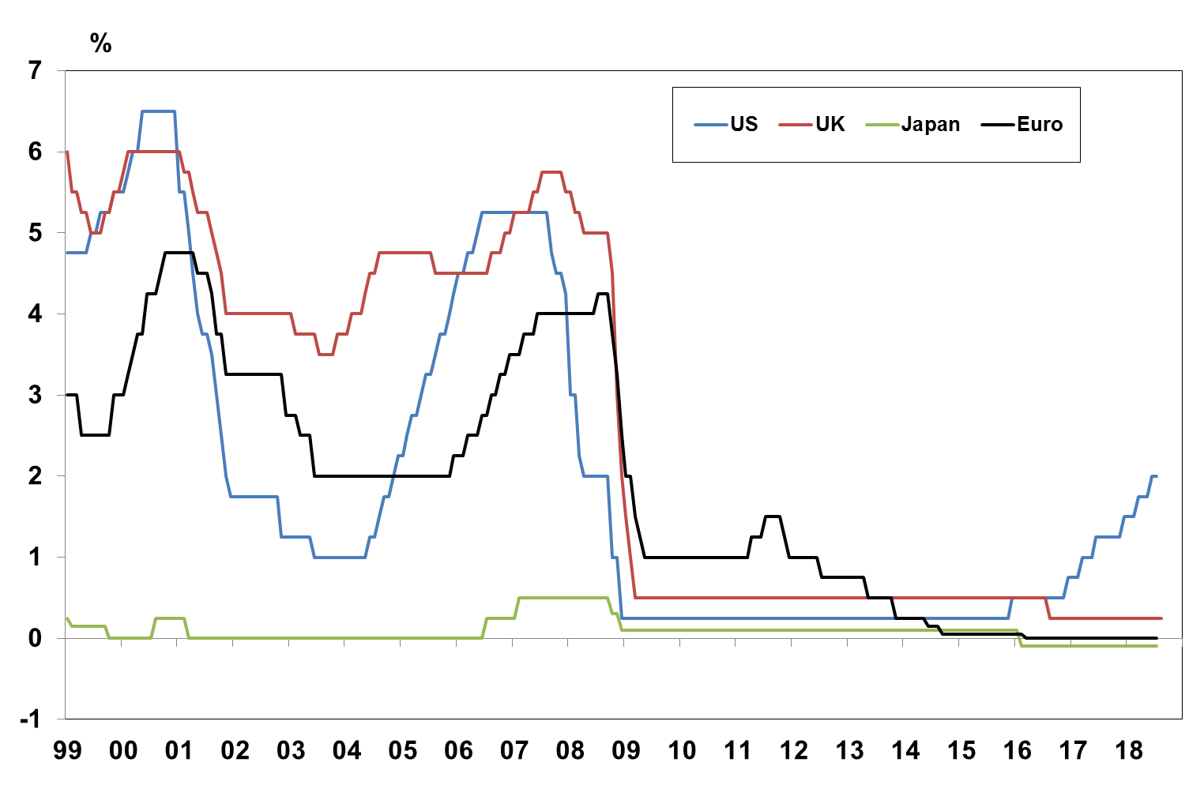
The root cause is a rise in general risk aversion among global investors
brought about the gradual rise in US interest rates
Source: Thompson Reuters
Nedbank Group Economic Unit

Slide 15
  Factors driving the rand weaker
A decline in general risk appetite among global investors, triggered mainly by:
The gradual rise in US interest rates and the expectation of the normalisation of monetary policy in most advanced countries have encouraged capital to move back to the US and other low-risk developed countries.
Higher US interest rates and the systematic measures taken to wind down the Federal Reserve’s large balance sheet are supporting the US dollar

Slide 16
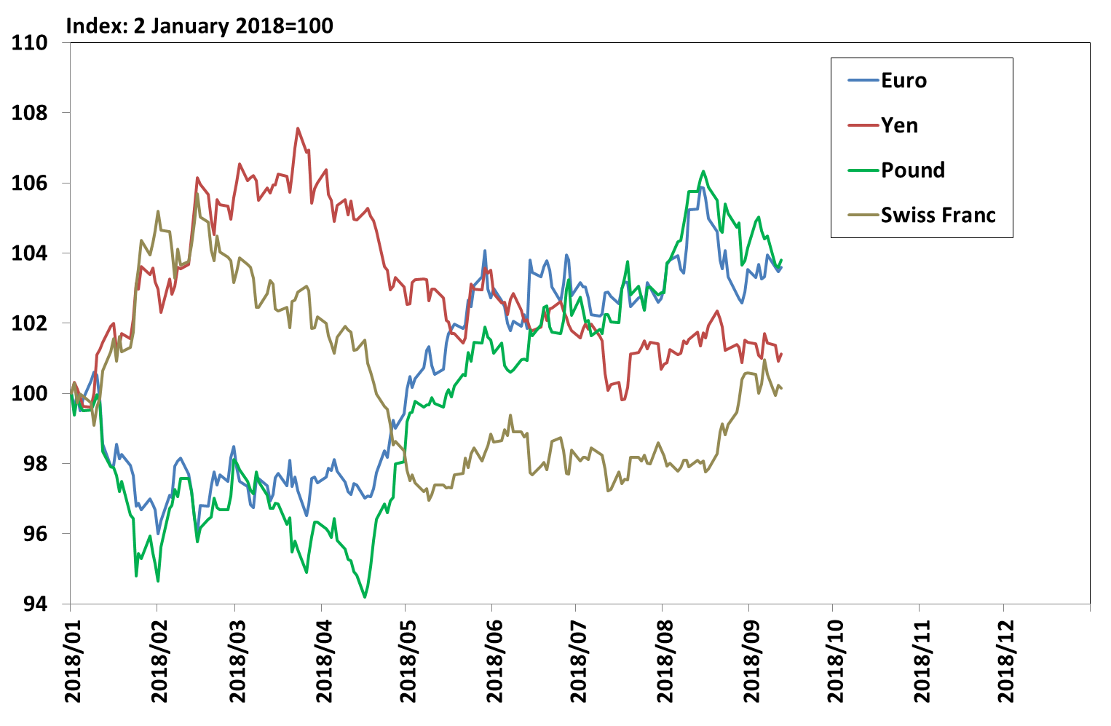
The rise in US interest rates & the unwinding of US Fed’s balance sheet are
also supporting the US dollar
Source: Thompson Reuters
Nedbank Group Economic Unit

Slide 17
  Factors driving the rand weaker
A decline in general risk appetite among global investors, triggered mainly by:
The gradual rise in US interest rates and the expectation of the normalisation of monetary policy in most advanced countries have encouraged capital to move back to the US and other low-risk developed countries.
Higher US interest rates and the systematic measures taken to wind down the Federal Reserve’s large balance sheet are supporting the US dollar
Rising US interest rates have also reduced the returns from the carry-trade (the margin made from borrowing in low interest rate/low risk currencies and investing in high interest rate/high risk currencies)
Small and open developing countries are widely considered the most vulnerable to the escalating trade war between the US and China, the EU, Canada and Mexico.

Slide 18
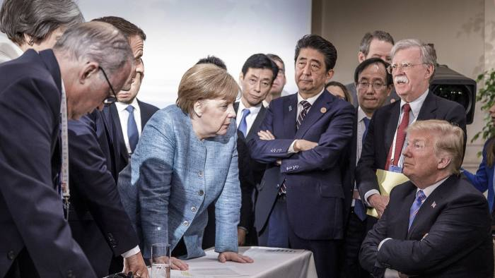
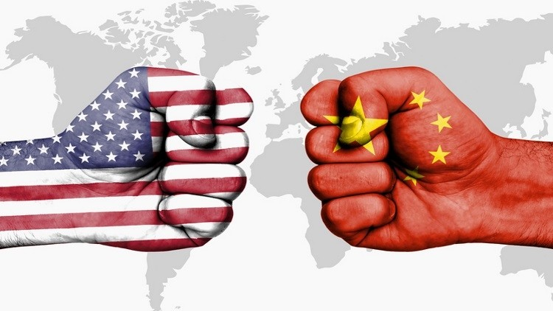
Small and open developing countries also considered the most vulnerable to the escalating trade war
The unfolding trade wars:
Trade wars driven by Trump’s ‘America first’ policy
US imposed tariffs on $34bn of Chinese goods, with possibility that another $16bn of goods could be targeted for infringements of US intellectual property.
Trump is now considering a 25% tariff on $200bn worth of Chinese goods.
China responded in kind, imposing import tariffs on US exports of around $50bn, targeting agriculture, vehicles, aircraft and goods likely to hurt Trump’s support base
US withdrew exemptions applying to steel & aluminium tariffs on Canada, EU and UK.
Canada retaliated with tariffs on selected US goods, while the EU recently released of US goods on which it will impose tariffs
Trade wars threaten to disrupt global supply chains, drive up production costs & hurt company profits

Slide 19
  Factors driving the rand weaker
A decline in general risk appetite among global investors, triggered mainly by:
The gradual rise in US interest rates and the expectation of the normalisation of monetary policy in most advanced countries have encouraged capital to move back to the US and other low-risk developed countries.
Higher US interest rates and the systematic measures taken to wind down the Federal Reserve’s large balance sheet are supporting the US dollar
Rising US interest rates have also reduced the returns from the carry-trade (the margin made from borrowing in low interest rate/low risk currencies and investing in high interest rate/high risk currencies)
Small and open developing countries are widely considered the most vulnerable to the escalating trade war between the US and China, the EU, Canada and Mexico.
Increased global protectionism and attempts by China to reign in rapid credit growth have cast considerable doubt over China’s growth prospects. Given that China is by far the largest consumer of commodities, slower growth in China will result in weaker demand for and prices of commodities, hurting exports and growth prospects in commodity-producing and exporting countries like Russia, Brazil, Colombia, Chile and South Africa

Slide 20
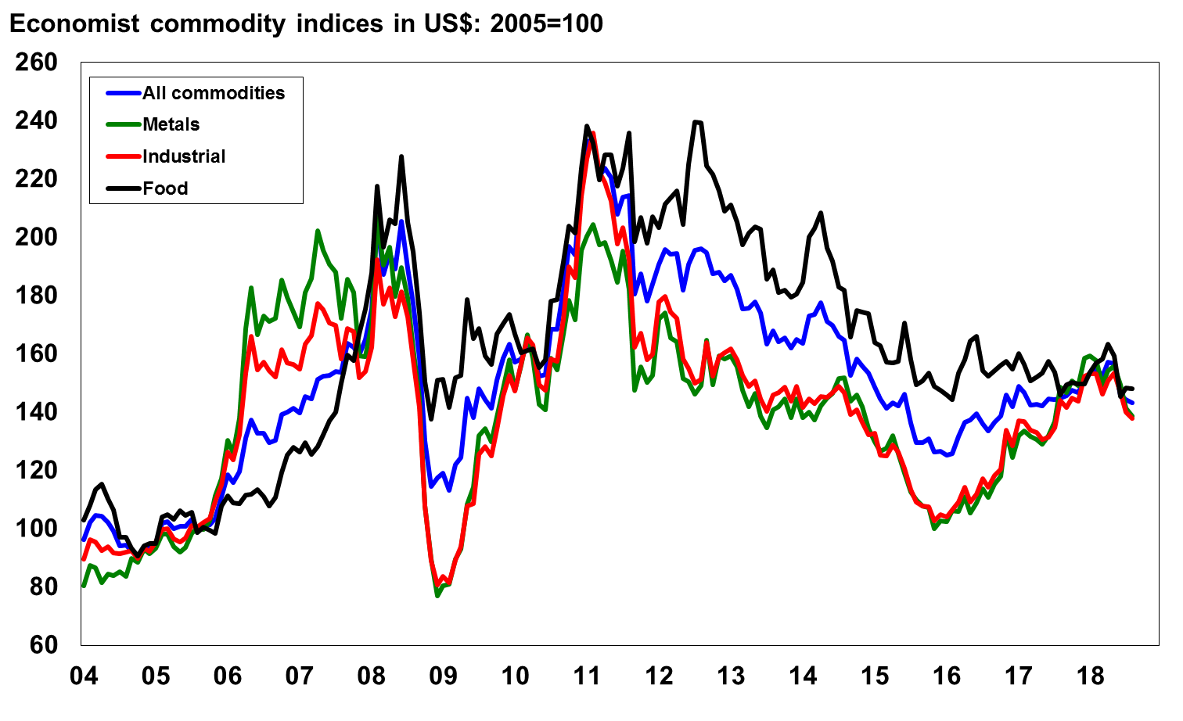
Global commodity prices are under renewed pressure on concerns over
China’s growth prospects and excess capacity in some commodities
Source: Economist $ Indices
Nedbank Group Economic Unit

Slide 21
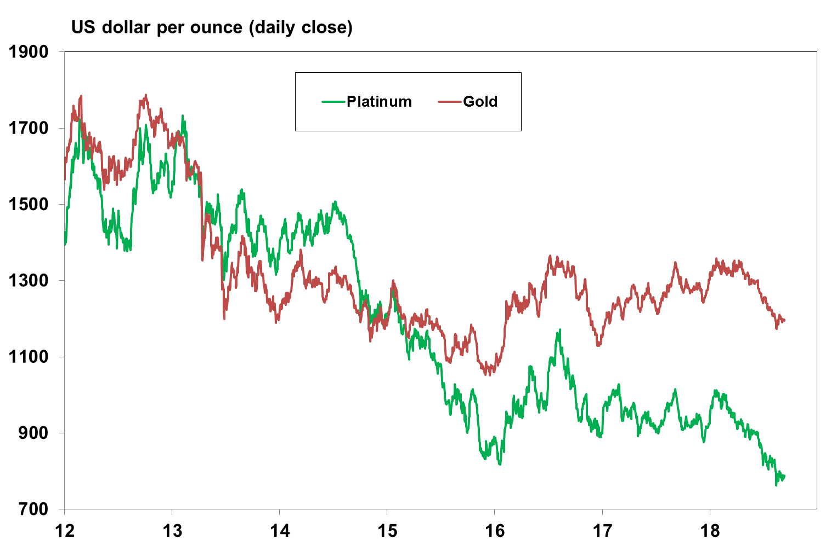
The prices of some of SA’s major exports are looking particularly grim
Source: Thompson Reuters
Nedbank Group Economic Unit

Slide 22
  Factors driving the rand weaker
A decline in general risk appetite among global investors, triggered mainly by:
The gradual rise in US interest rates and the expectation of the normalisation of monetary policy in most advanced countries have encouraged capital to move back to the US and other low-risk developed countries.
Higher US interest rates and the systematic measures taken to wind down the Federal Reserve’s large balance sheet are supporting the US dollar
Rising US interest rates have also reduced the returns from the carry-trade (the margin made from borrowing in low interest rate/low risk currencies and investing in high interest rate/high risk currencies)
Small and open developing countries are widely considered the most vulnerable to the escalating trade war between the US and China, the EU, Canada and Mexico.
Increased global protectionism and attempts by China to reign in rapid credit growth have cast considerable doubt over China’s growth prospects. Given that China is by far the largest consumer of commodities, slower growth in China will result in weaker demand for and prices of commodities, hurting exports and growth prospects in commodity-producing and exporting countries like Russia, Brazil, Colombia, Chile and South Africa
Growing risk aversion towards specific emerging and developing economies
Some emerging markets are also considered far more vulnerable than others to the reversal in global capital flows. These include those countries that are highly dependent on foreign funding as reflected by the presence of twin fiscal and current account deficits, low levels of foreign currency reserves, weak policy credibility fuelled by political turmoil, corruption and cronyism as well as those countries with considerable structural constraints to faster economic growth.

Slide 23
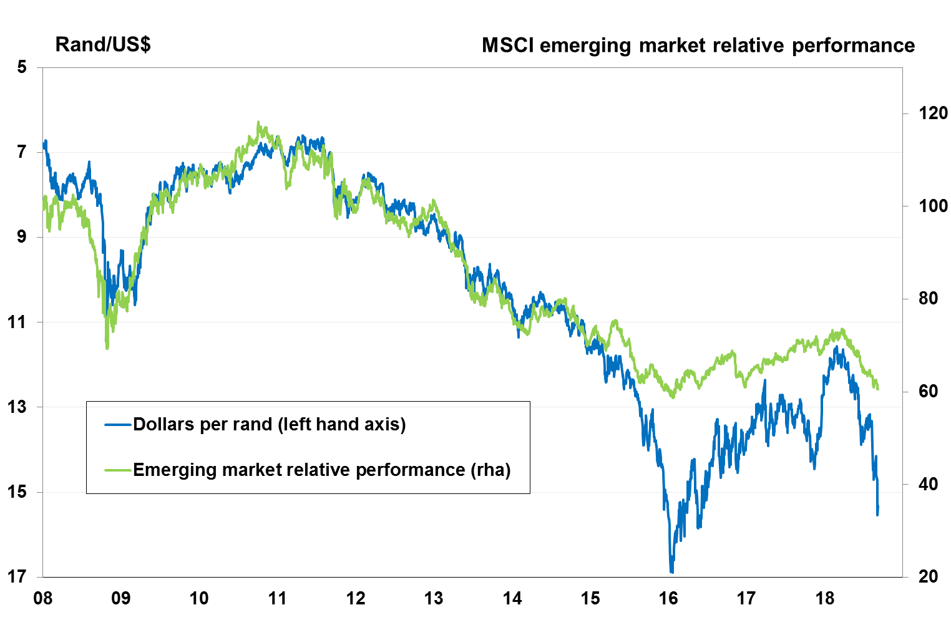
All these factors combined have undermined global risk appetite for emerging market assets in general
Sources: NGEU

Slide 24
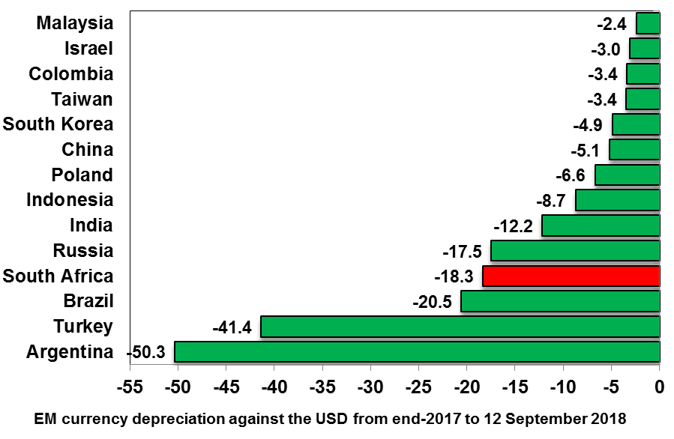
Most emerging market currencies have been under pressure, but some
countries have been hurt far more than others
Source: Thompson Reuters
Nedbank Group Economic Unit

Slide 25
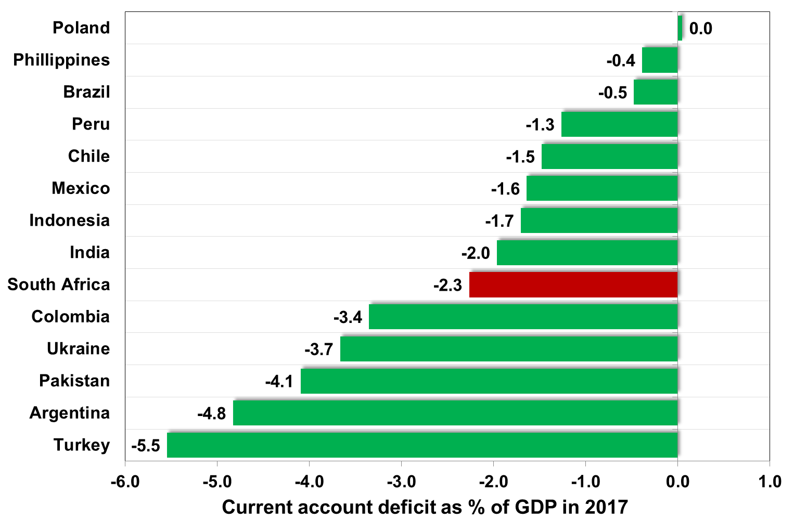
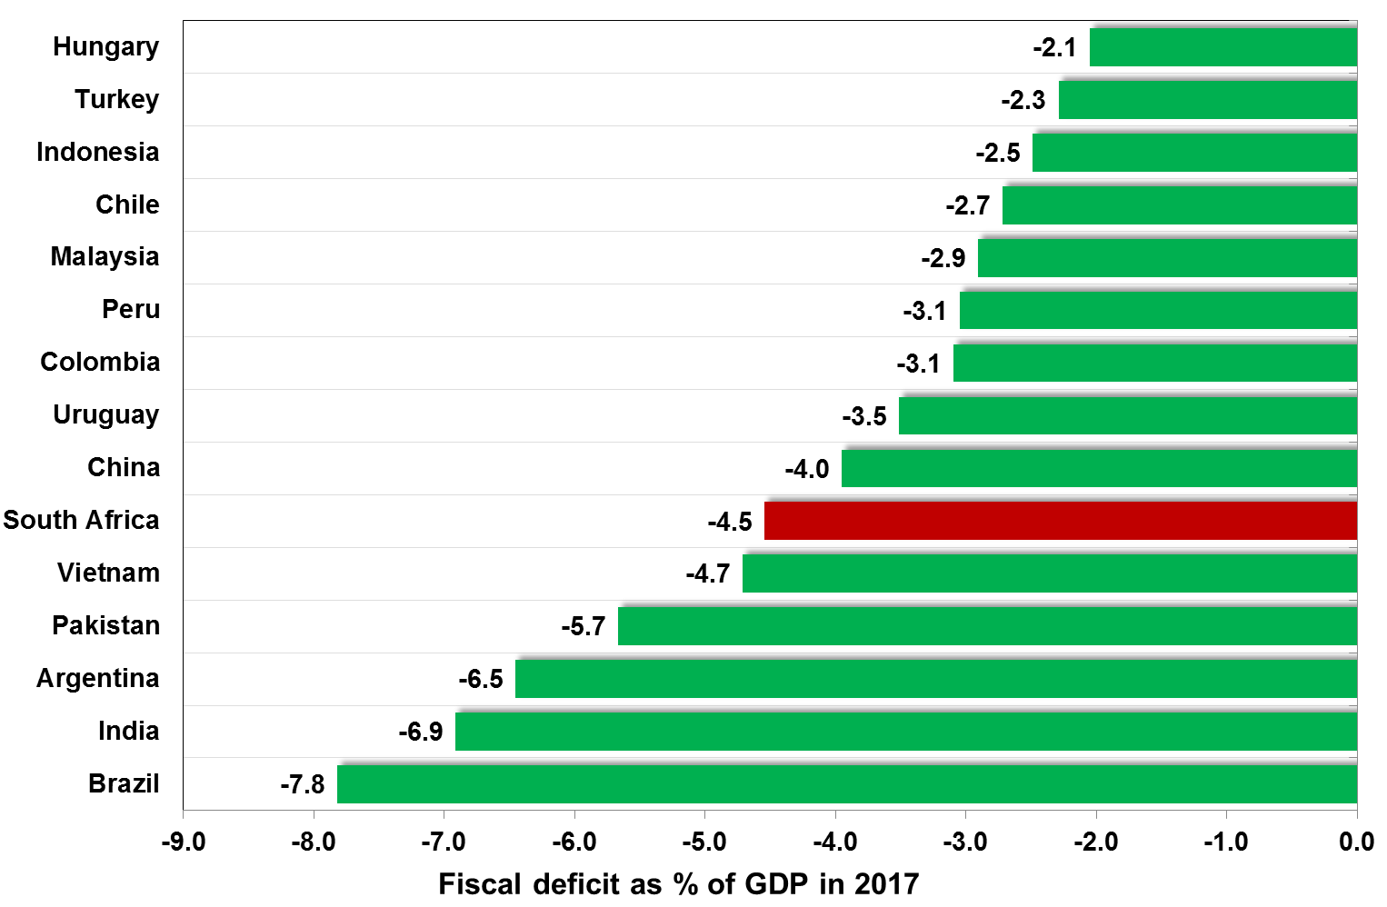
The heaviest selling was directed at countries with large twin current account deficits and fiscal deficits
Current account deficit
Fiscal deficits
Source: IMF April 2018

Slide 26
The hardest hit were those with large foreign debt burdens (especially short-term $ debt) with limited foreign exchange earnings
Source: Global Insight

Slide 27
  The rand outlook remains uncertain
Likely path of medium term drivers
The underlying shift towards risk-off by global investors will probably continue in spells throughout this year and much of next year.
This is mainly due to the expectation that the US and other advanced countries will probably continue to normalise monetary policy, while any reversal in the surge in protectionism appears unlikely under the current US political administration.
Emerging markets will therefore remain vulnerable to bouts of selling.
The rand will be under more pressure if South Africa fails to implement essential fiscal and structural reforms or adds to already high levels of policy uncertainty, which could result in further sovereign risk rating downgrades and South Africa’s exclusion from some major global bond indices.
We expect the rand to drift lower over the next two years.
Some short-term pullback is likely as sell-off from emerging markets in general and the rand in particular appears overdone

Slide 28
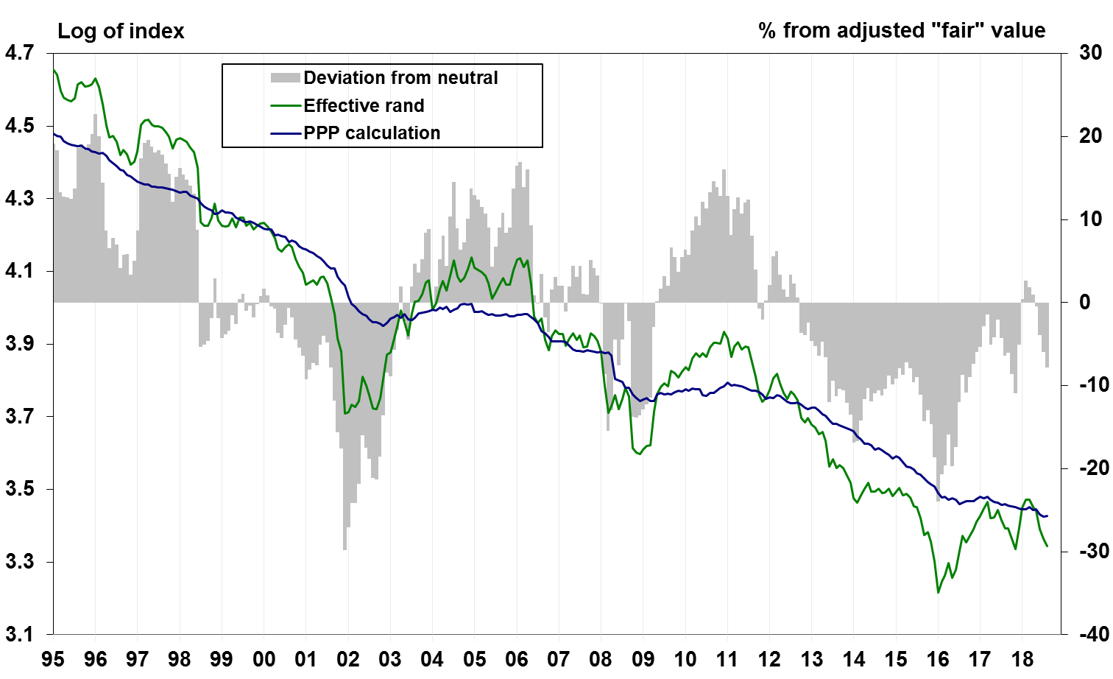
The rand now appears undervalued based on Nedbank’s calculation of
purchasing power parity
Source: Thompson Reuters
Nedbank Group Economic Unit

Slide 29
  The rand outlook remains uncertain
Some short-term pullback is likely as sell-off from emerging markets in general and the rand in particular appears overdone
Likely path of medium term drivers
The underlying shift towards risk-off by global investors will probably continue in spells throughout this year and much of next year.
This is mainly due to the expectation that the US and other advanced countries will probably continue to normalise monetary policy, while any reversal in the surge in protectionism appears unlikely under the current US political administration.
Emerging markets will therefore remain vulnerable to bouts of selling.
The rand will be under more pressure if South Africa fails to implement essential fiscal and structural reforms or adds to already high levels of policy uncertainty, which could result in further sovereign risk rating downgrades and South Africa’s exclusion from some major global bond indices.
We expect the rand to drift lower over the next two years.

Slide 30
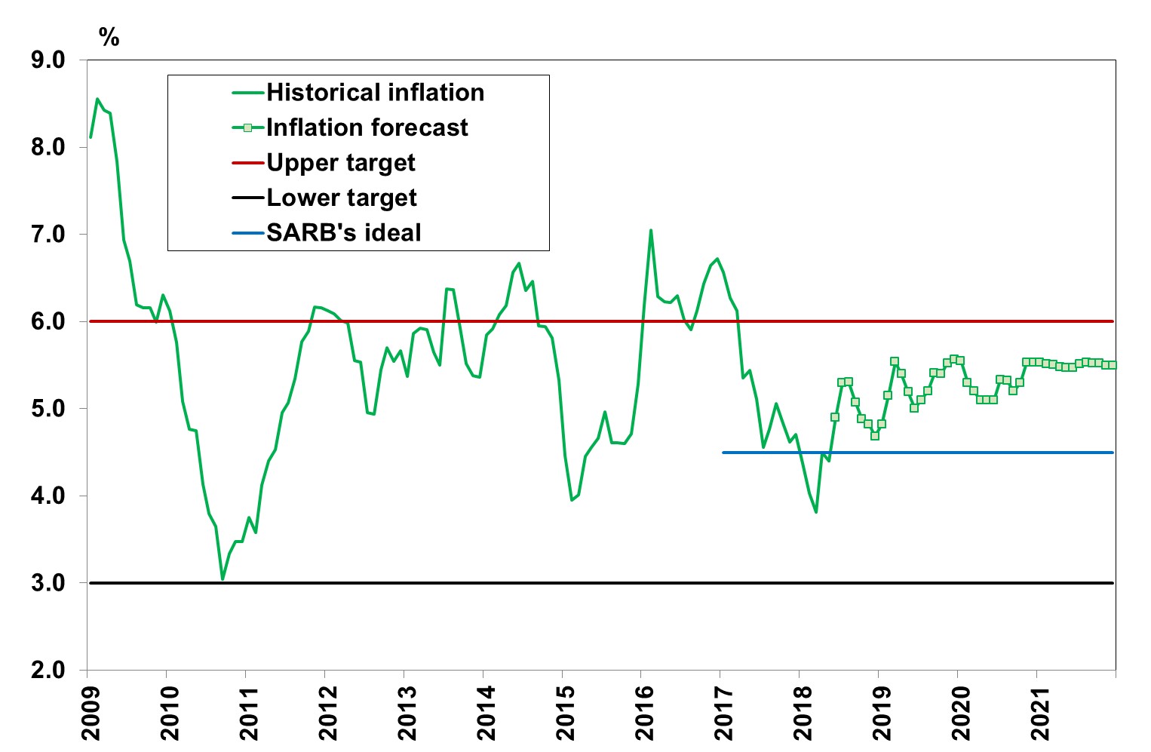
Inflation is expected to rise moderately in the months ahead & remain sticky above 5%.
Sources: Stats SA

Slide 31
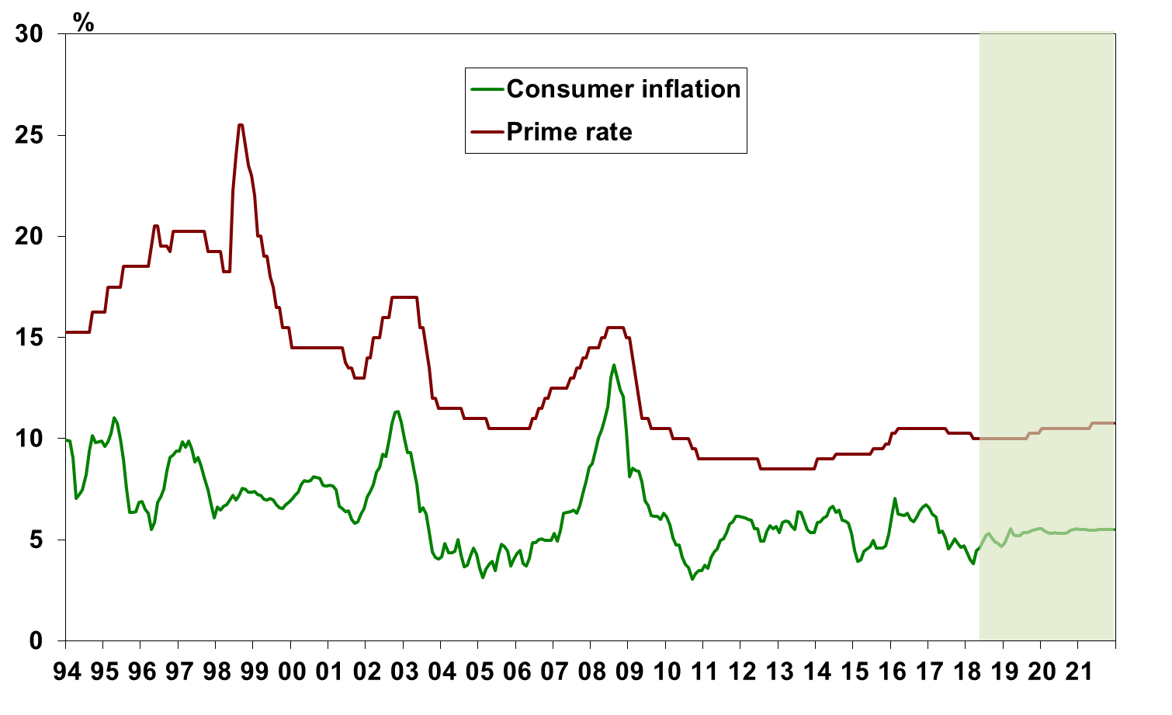
Interest rates are forecast to remain steady until the second half of next year, when SARB is expected to embark on a mild tightening
Sources: NGEU

Slide 32
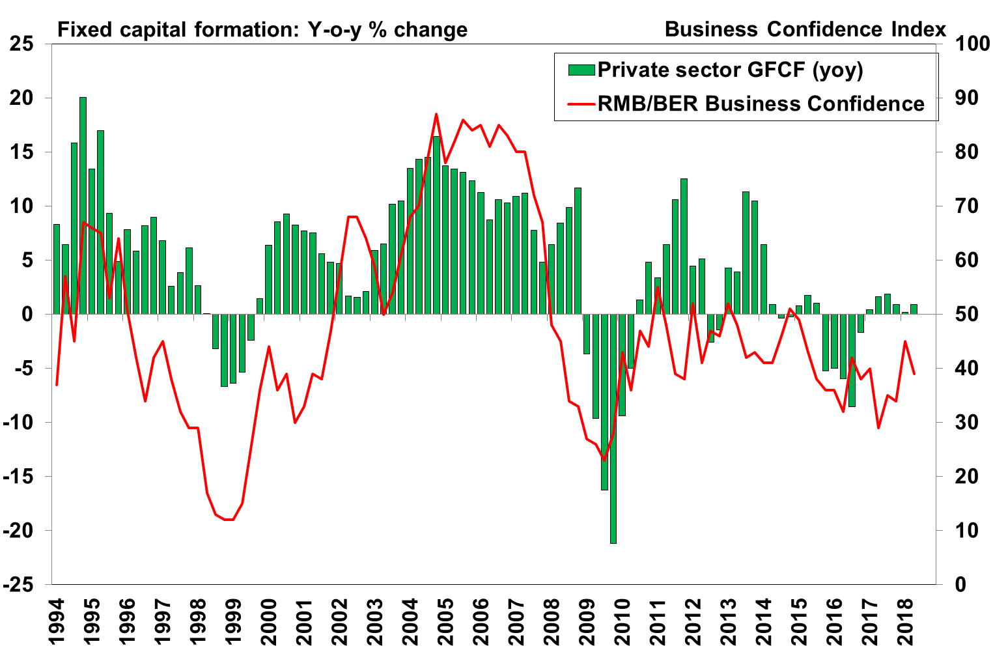
A revival in private sector fixed investment is essential for faster growth &
Increased job creation

Slide 33
  Fixed investment will only recover when the expected return from expansion outweighs the perceived risks
Policy uncertainty persists and continues to add to risk of investing in SA
  New mining charter still places a significant empowerment burden on companies
  Expropriation without compensation poses threat to investor confidence, property prices, food security and agriculture and the soundness of the banking sector
  NHI poses a threat to the private health care industry
Poor growth prospects
  Fiscal consolidation, structural constraints and poor policy choices continue to undermine domestic growth prospects
Companies have to operate in a challenging environment where factors outside their control continue to drive production costs higher
  Complex, cumbersome and expensive regulatory and legislative environment
  A dysfunctional labour market with aggressive and powerful unions
  Expensive, unreliable and insufficient economic infrastructure provided by financially-broken and operationally-crippled SOEs
  Damage done by broken SOEs should not be underestimated. Over 300% surge in electricity tariffs since 2007 has hallowed out traditional areas of production (mining & manufacturing)

Slide 34
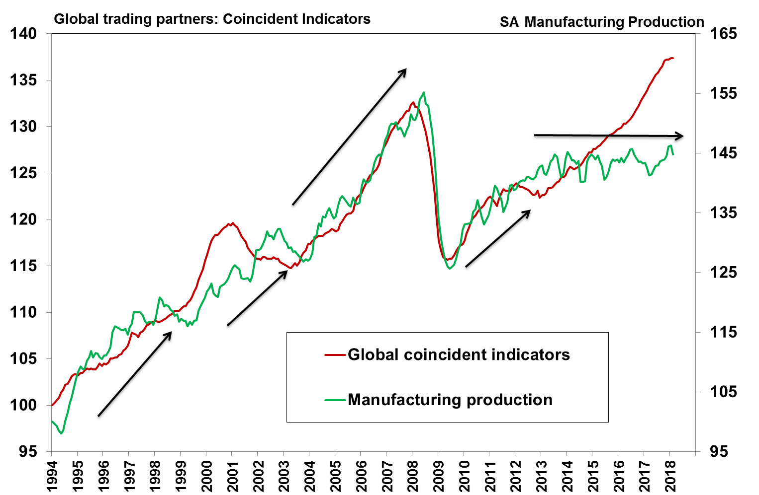
This challenging operating environment is why manufacturing has been so slow to respond to a generally favourable global economy
Sources: SARB & StatsSA

Slide 35
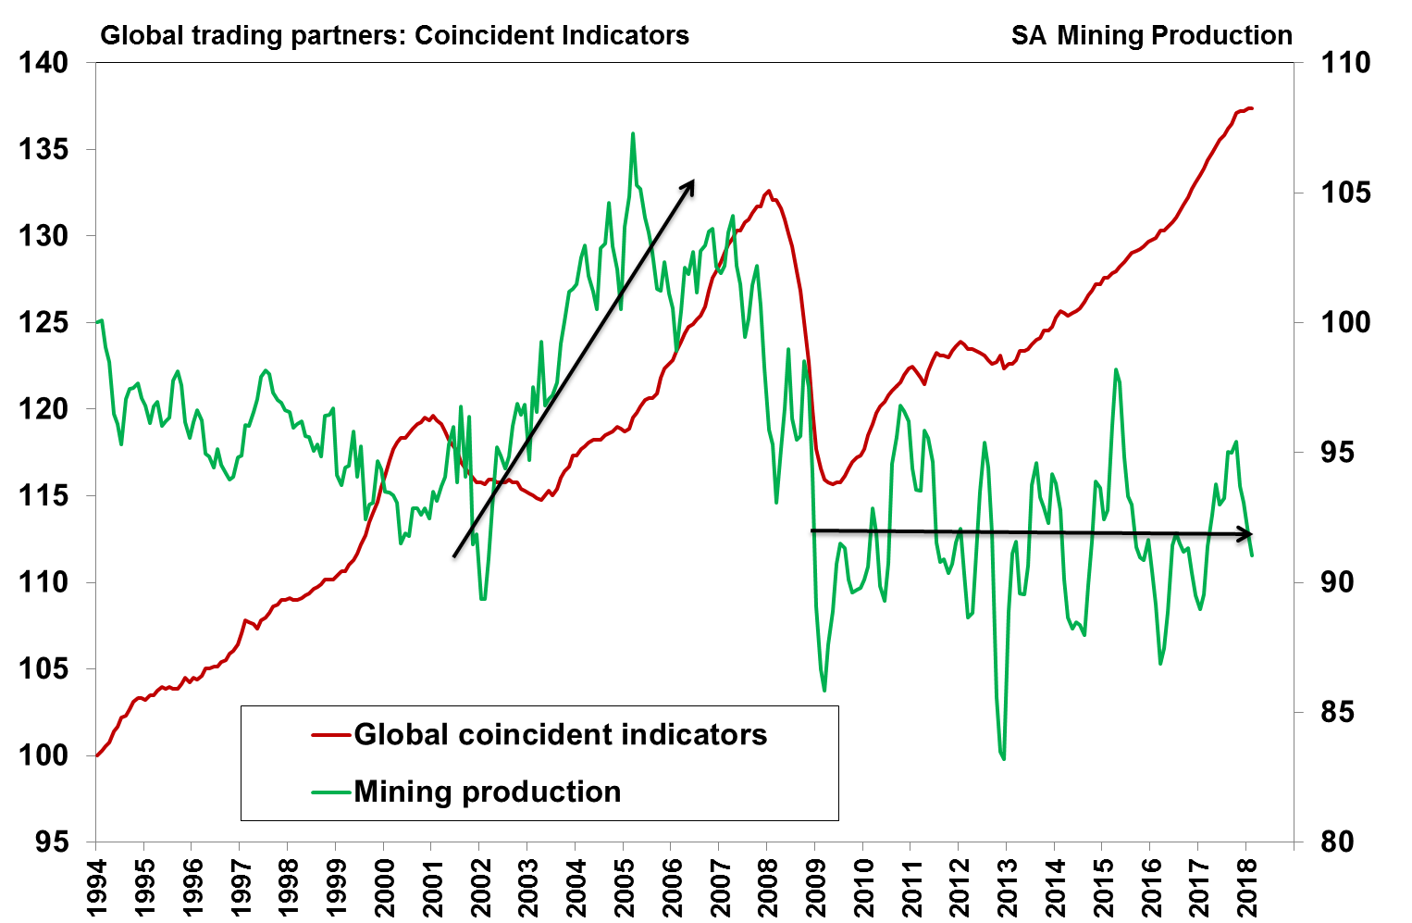
It is the same reason why mining has been equally unresponsive
Sources: SARB & StatsSA

Slide 36
The IMF still expects relatively robust global growth in 2018 and 2019,
but the downside risks have increased especially for EMs
Source: IMF WEO April 2018
Nedbank Group Economic Unit

Slide 37
Overall the economy should fare moderately better over the next 3 years
Nedbank Group Economic Unit

Slide 38
Thank you.

Slide 39
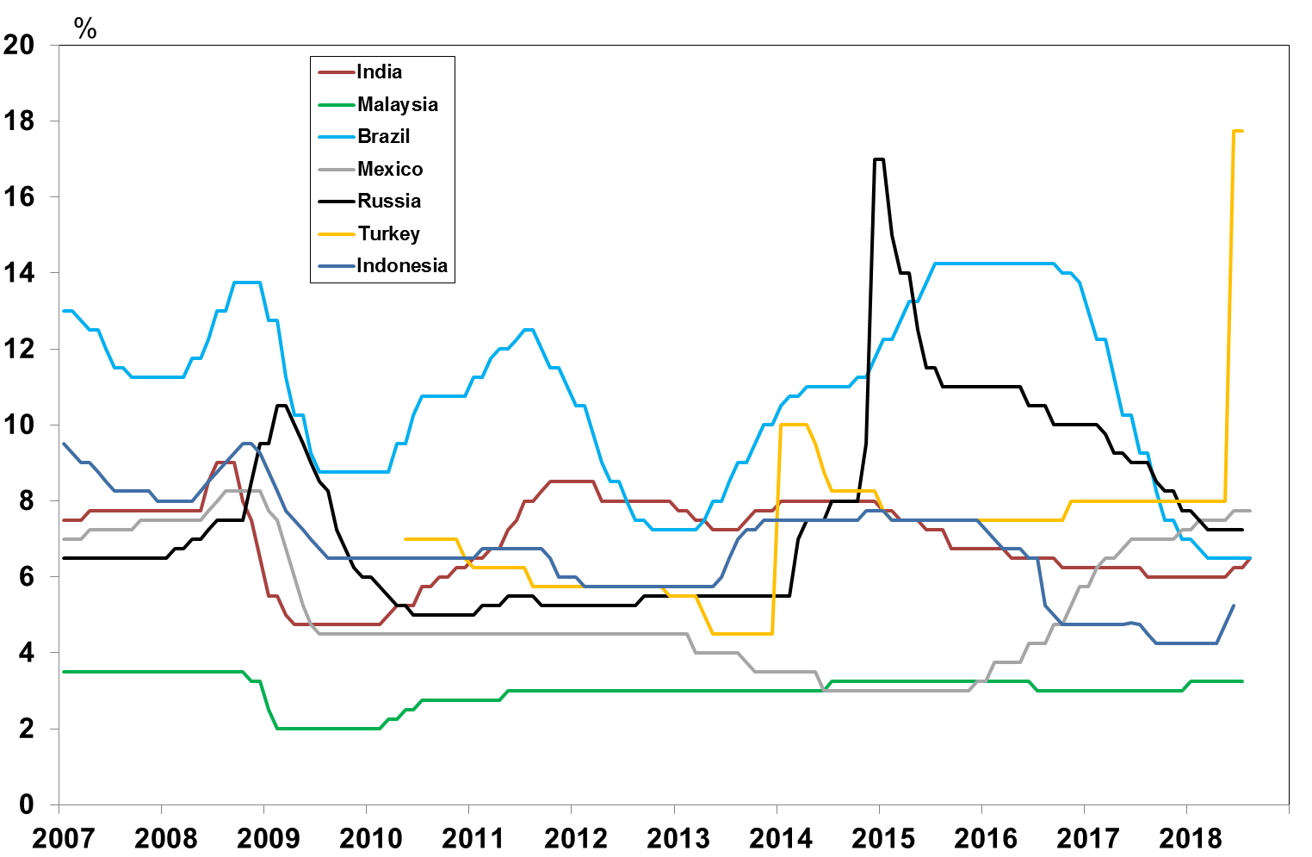
The rand has also been under a little bit more pressure as most of SA’s
peers have hiked interest rates to compensate for higher risks
Source: Thompson Reuters
Nedbank Group Economic Unit

