Slide 1




Why some countries are rich
and others poor.
The relationship between economic growth
and economic complexity.
Francois Fouche
14 Sept 2018

Slide 2
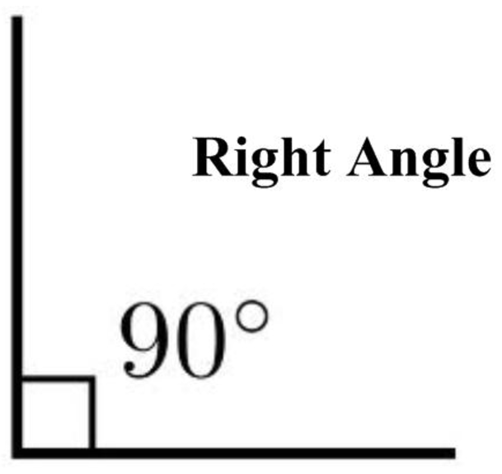
Why do we share research?
A different angle of looking at our challenges.

Slide 3
Ask better questions… to get better answers

Slide 4
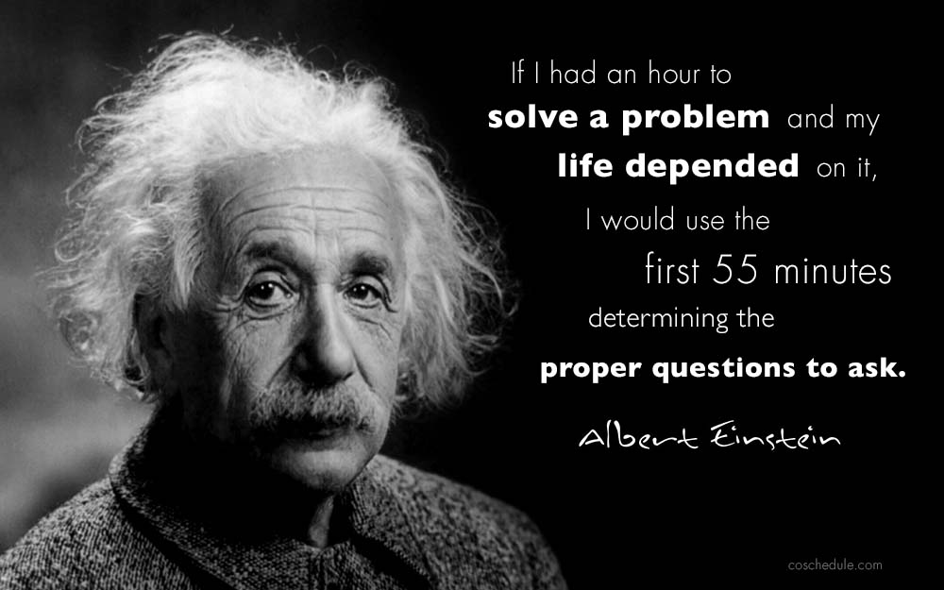
Ask better questions… to get better answers
Spotprent

Slide 5

The knowledge era

Slide 6
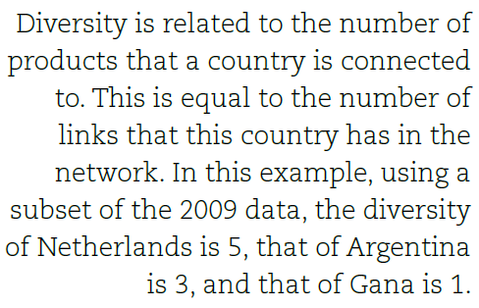
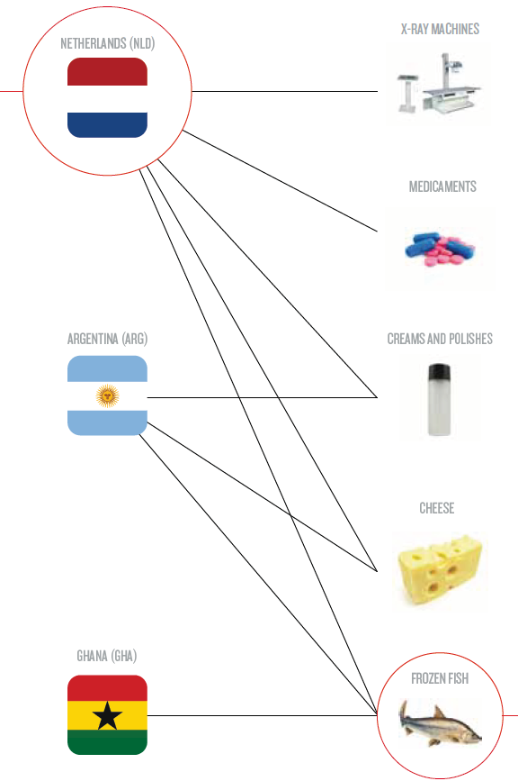
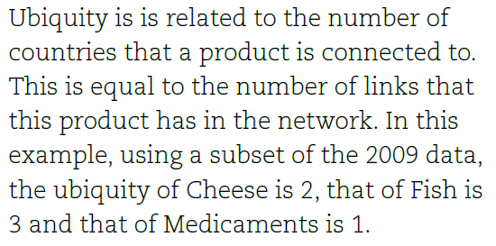
What is Economic Complexity (EC)?
1
2
Source: The Atlas of Economic Complexity,
Mapping Paths to Prosperity, Harvard University. Hausmann Ricardo, Hidalgo César, et al.

Slide 7
What is Economic Complexity (EC)?
1
2
Source: The Atlas of Economic Complexity,
Mapping Paths to Prosperity, Harvard University. Hausmann Ricardo, Hidalgo César, et al.

Slide 8
What is Economic Complexity (EC)?
1
2
Source: The Atlas of Economic Complexity,
Mapping Paths to Prosperity, Harvard University. Hausmann Ricardo, Hidalgo César, et al.

Slide 9
The theory of Economic Complexity (EC)
How do countries achieve economic growth?
  Diversity & sophistication of a country’s productive capabilities best defines why countries are rich or poor.
  This is referred to as economic complexity (EC).
The more…
  Diverse a country is in its productive capabilities, the
  More complex its exports, the
  Faster its economic growth.
The explanatory power of exports
  Growth predictions using EC were significantly more accurate vs. conventional growth metrics - such as the world governance indicators.
Source: The Atlas of Economic Complexity, Mapping Paths to Prosperity, Harvard University. Hausmann Ricardo, Hidalgo César, et al.

Slide 10
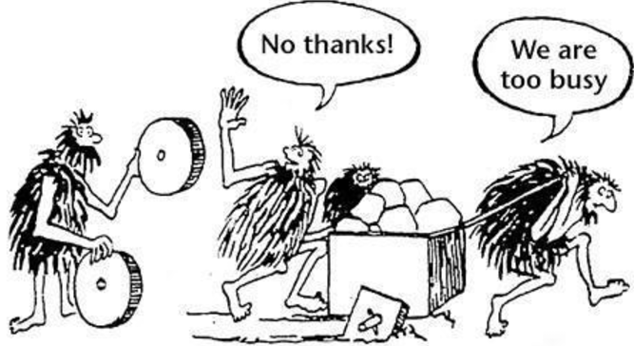
Economic growth
Everybody wants growth, but nobody wants to change.

Slide 11
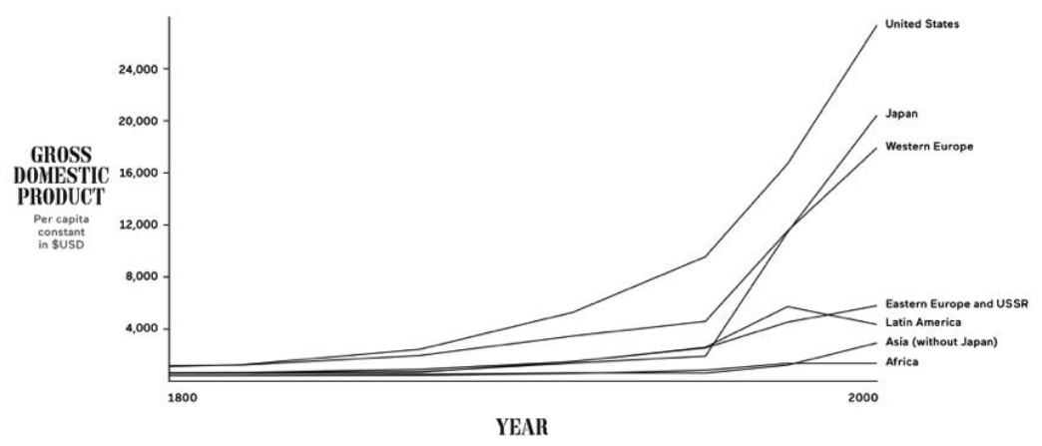
The great acceleration
Source: Maddison, 2008.

Slide 12
The great divergence
4x
250x
Source: Maddison, 2008.

Slide 13
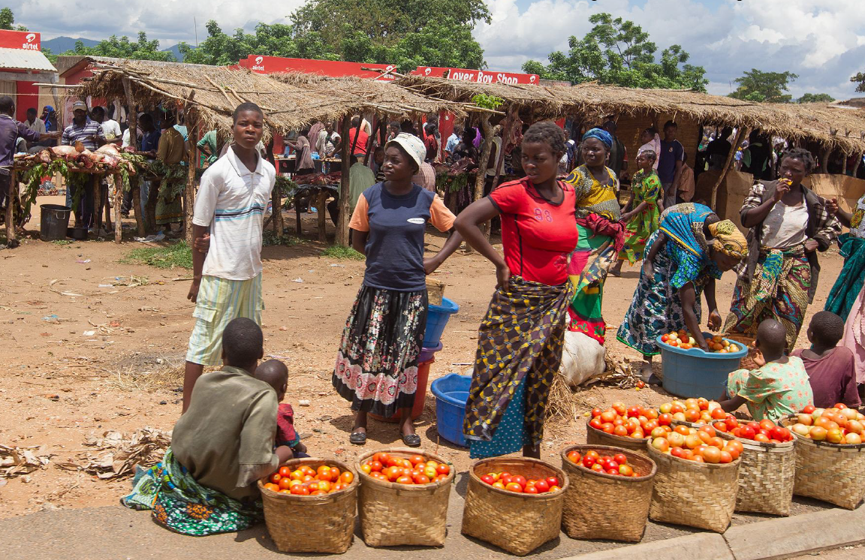
Malawi - $226 per capita

Slide 14

Haiti - $819 per capita

Slide 15

Morocco - $3,108 per capita

Slide 16
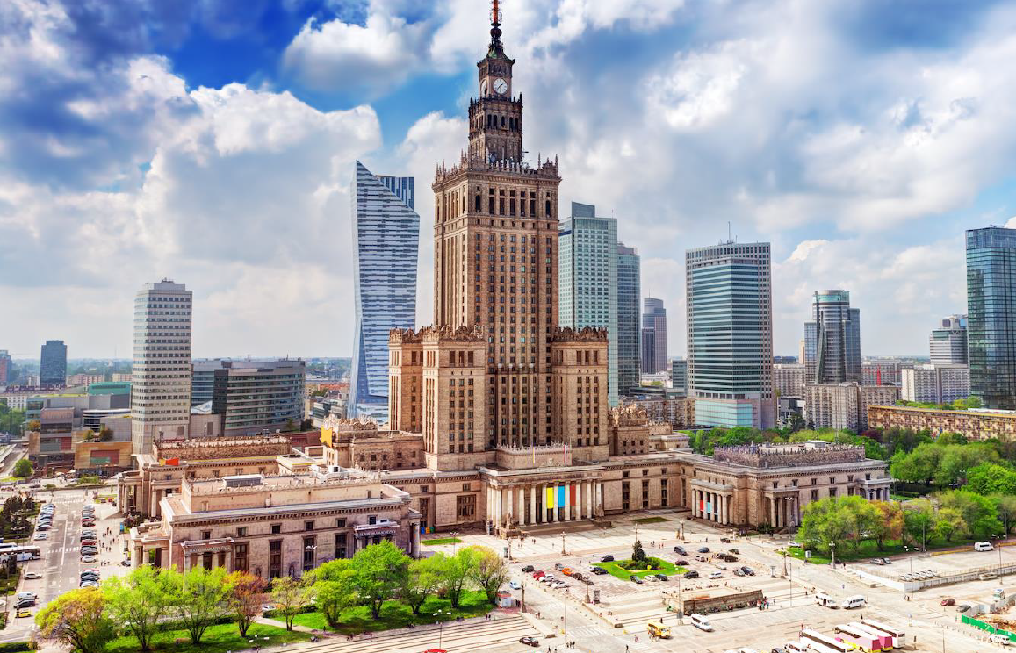
Poland - $13,431 per capita

Slide 17

Singapore - $55,182 per capita

Slide 18
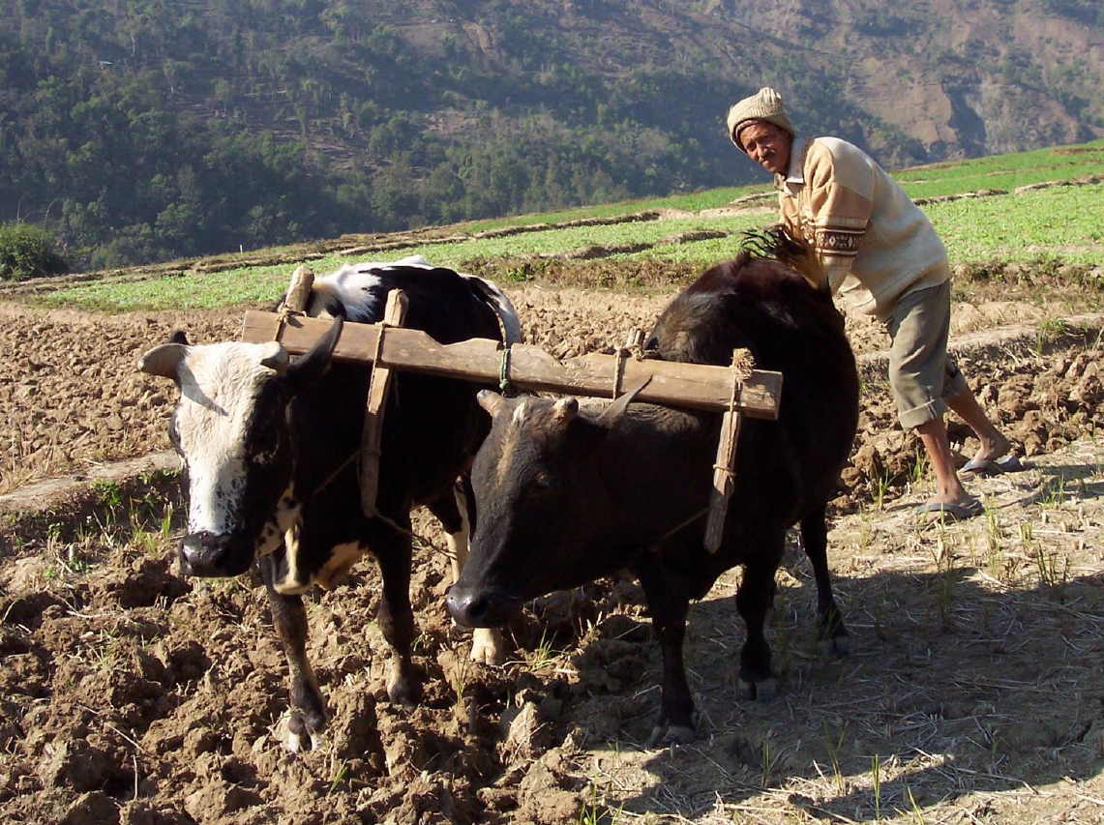
Why do we still have this and …
Output low.
Productivity low.
Low industry network capability.
Risk mitigation impossible.
Inevitable low income.

Slide 19

… this?
Output high.
Productivity high.
High industry network capability.
Risk mitigation possible.
Higher income possible.

Slide 20
Why do these systems co-exist?
The problem
It is not a 4x problem anymore.
It is now a > 250x problem.
Not only across countries, but within countries
Within countries (regions/provinces/cities).
However, they have the same macro conditions & structure;
  Same legal framework, same judicial system;
  Same political representation system, same monetary system;
  Same interest rates, same exchange rate;
  Same political system, same financial architecture;
  Mostly the same language & religion;
Yet, significant differences in output & productivity remain.
Why is the growth explosion not better distributed?

Slide 21

The orthodox answer
Conventional Economics
The 4 factors of production.
The inputs to produce the output.
What is used to produce goods and services.
The building blocks of an the economy.
Entrepreneurship
Human Capital
Enterprise

Slide 22


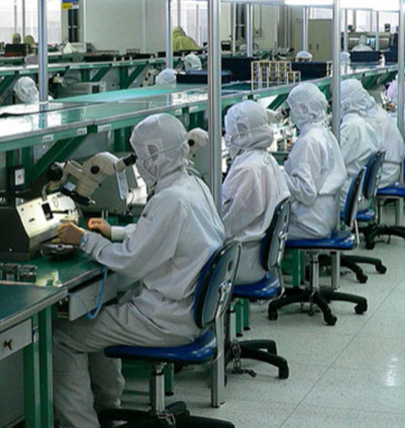
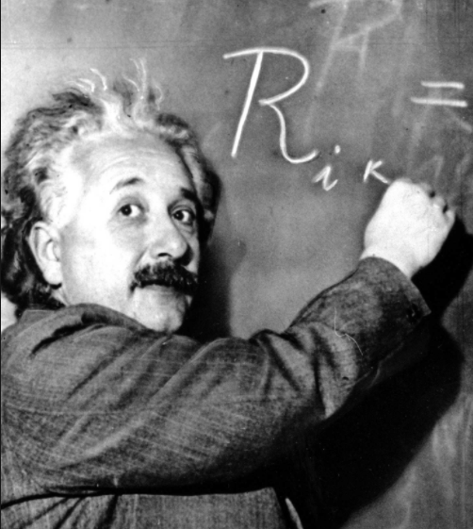
4 Factors of production
Capital
Land
Labour
Human Capital

Slide 23
What explains the differences in output?
Is it because access to / availability of production factors?
Capital
  More capital?
  Access to capital?
  Cost of capital?
Human capital
  More schooling?
  Better education?
And then the result?
  As a consequence, more output is then generated.

Slide 24
No
Reading Adam Smith does not help
Capital
Land
Labour
Human Capital

Slide 25

So what explains growth differences?
Credit to conventional Economics
  They discovered the answer is not here.
  Factors of production does not explain growth differences.
It received a name
  The “residual”.
  “Total” factor productivity.
  Clever way of saying “it is a measure of our ignorance”.
  The stuff that nobody knows what it is…
  … so we call it “technology”
Fundamental question we try to answer
  Why does “technology” not diffuse / spread?
  What is the structure of “technology”?
  Why do we observe these spectacular growth differences?
Grey
area

Slide 26
So what explains growth differences?
Credit to conventional Economics
  They discovered the answer is not here.
  Factors of production does not explain growth differences.
It received a name
  The “residual”.
  “Total” factor productivity.
  Clever way of saying “it is a measure of our ignorance”.
  The stuff that nobody knows what it is…
  … so we call it “technology”
Fundamental question we try to answer
  Why does “technology” not diffuse / spread?
  What is the structure of “technology”?
  Why do we observe these spectacular growth differences?
Grey
area

Slide 27
So what explains growth differences?
Credit to conventional Economics
  They discovered the answer is not here.
  Factors of production does not explain growth differences.
It received a name
  The “residual”.
  “Total” factor productivity.
  Clever way of saying “it is a measure of our ignorance”.
  The stuff that nobody knows what it is…
  … so we call it “technology”
Fundamental question we try to answer
  Why does “technology” not diffuse / spread?
  What is the structure of “technology”?
  Why do we observe these spectacular growth differences?
Grey
area

Slide 28
So what explains growth differences?
Credit to conventional Economics
  They discovered the answer is not here.
  Factors of production does not explain growth differences.
It received a name
  The “residual”.
  “Total” factor productivity.
  Clever way of saying “it is a measure of our ignorance”.
  The stuff that nobody knows what it is…
  … so we call it “technology”
Fundamental question we try to answer
  Why does “technology” not diffuse / spread?
  What is the structure of “technology”?
  Why do we observe these spectacular growth differences?
Grey
area

Slide 29
So what explains growth differences?
Credit to conventional Economics
  They discovered the answer is not here.
  Factors of production does not explain growth differences.
It received a name
  The “residual”.
  “Total” factor productivity.
  Clever way of saying “it is a measure of our ignorance”.
  The stuff that nobody knows what it is…
  … so we call it “technology”
Fundamental question we try to answer
  Why does “technology” not diffuse / spread?
  What is the structure of “technology”?
  Why do we observe these spectacular growth differences?
Grey
area

Slide 30
So what explains growth differences?
Credit to conventional Economics
  They discovered the answer is not here.
  Factors of production does not explain growth differences.
It received a name
  The “residual”.
  “Total” factor productivity.
  Clever way of saying “it is a measure of our ignorance”.
  The stuff that nobody knows what it is…
  … so we call it “technology”
Fundamental question we try to answer
  Why does “technology” not diffuse / spread?
  What is the structure of “technology”?
  Why do we observe these spectacular growth differences?
Grey
area

Slide 31
So what explains growth differences?
Credit to conventional Economics
  They discovered the answer is not here.
  Factors of production does not explain growth differences.
It received a name
  The “residual”.
  “Total” factor productivity.
  Clever way of saying “it is a measure of our ignorance”.
  The stuff that nobody knows what it is…
  … so we call it “technology”
Fundamental question we try to answer
  Why does “technology” not diffuse / spread?
  What is the structure of “technology”?
  Why do we observe these spectacular growth differences?
Grey
area

Slide 32
Conventional development path
Rich countries
  Are rich because they exploit technological progress.
  Move the bulk of their labour force out of agriculture into cities.
  Knowhow can be shared more easily in cities.
  Their families have fewer children.
  They educate them more intensively…
…thereby facilitating further technological progress.
Poor countries
  Poor countries require similar change to become rich.
  Reduce farm employment, become more urban.
  Have fewer children, and keep those children that they have in school longer.
  If they do, the doors to prosperity will open…
  …is that the case?

Slide 33
Conventional development path
Rich countries
  Are rich because they exploit technological progress.
  Move the bulk of their labour force out of agriculture into cities.
  Knowhow can be shared more easily in cities.
  Their families have fewer children.
  They educate them more intensively…
…thereby facilitating further technological progress.
Poor countries
  Poor countries require similar change to become rich.
  Reduce farm employment, become more urban.
  Have fewer children & keep children in school for longer.
  If they do, the doors to prosperity will open…
  …is that the case?

Slide 34
Is education the missing link?

Slide 35
Is education the missing link?

Slide 36
Is education the missing link?

Slide 37
Is education the missing link?

Slide 38
Is education the missing link?
Even quality of education cannot explain that large a gap.
Something else is missing.

Slide 39
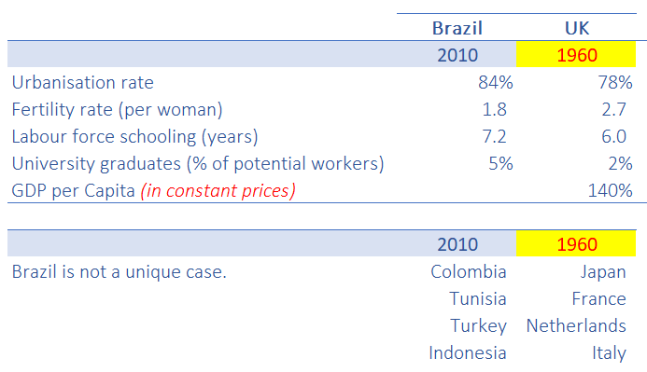
Comparing social indicators over time

Slide 40
Comparing social indicators over time

Slide 41
Comparing social indicators over time

Slide 42
Comparing social indicators over time
  What about the technological advances of the last 50 years?
  Computers, cellphones, internet, Teflon, etc.
  It should have enabled higher productivity.

Slide 43
What are we missing?
Why?
Is today’s smaller and more educated, urbanised families in emerging market economies so much less productive than their counterparts (in rich countries) were 50 years ago?
Can’t today’s emerging markets replicate levels of productivity that were achieved in countries with worse social indicators and older technologies?

Slide 44
What are we missing?
Why?
Is today’s smaller and more educated, urbanised families in emerging market economies so much less productive than their counterparts (in rich countries) were 50 years ago?
Can’t today’s emerging markets replicate levels of productivity that were achieved in countries with worse social indicators and older technologies?
  The key to this puzzle… may relate to “tacit” knowledge…
  To make stuff, you need to knowhow to make it, and this knowledge is, to a large extent, latent – not available in books, but stored in brains of those who need to use it.

Slide 45
For countries – collective knowhow
Collective productive knowhow
  Is driving these economic growth differences.
The reason the USA is 25x richer,
  Is not because are producing 25x per capita of the stuff that it produced 200 years ago.
Instead, the US is producing
  Completely different things with completely different methods.
Not only a quantitative change, but
A change in what gets produced.

Slide 46
For countries – collective knowhow
Collective productive knowhow
  Is driving these economic growth differences.
The reason the USA is 250x richer,
  Is not because are producing 250x per capita of the stuff that it produced 200 years ago.
Instead, the US is producing
  Completely different things with completely different methods.
Not only a quantitative change, but
A change in what gets produced.

Slide 47
For countries – collective knowhow
Collective productive knowhow
  Is driving these economic growth differences.
The reason the USA is 250x richer,
  Is not because are producing 250x per capita of the stuff that it produced 200 years ago.
Instead, the US is producing
  Completely different things with completely different methods.
Not only a quantitative change, but
A change in what gets produced.

Slide 48
For countries – collective knowhow
Collective productive knowhow
  Is driving these economic growth differences.
The reason the USA is 250x richer,
  Is not because are producing 250x per capita of the stuff that it produced 200 years ago.
Instead, the US is producing
  Completely different things with completely different methods.
Not only a quantitative change, but
A change in what gets produced.

Slide 49





None of these products existed 200 years ago

Slide 50

What is knowhow?
Knowhow
is not comprehension.
Knowhow
is not knowledge.
Knowing
history (facts like: dates, places, people)
does not equal knowhow.
Knowhow
= competence to perform a task.

Slide 51
What is knowhow?
Knowhow
is not comprehension.
Knowhow
is not knowledge.
Knowing
history (facts like: dates, places, people)
does not equal knowhow.
Knowhow
= competence to perform a task.

Slide 52


What is tacit knowhow?

Slide 53


Tacit knowhow takes time
1984

Slide 54
Tacit knowhow takes time
Imitation & repetition.
Until the brain is rewired.
Not transmitted via understanding only.
1984

Slide 55

Typically 10,000 hours to expert level

Slide 56

The scrabble theory…
… of
economic development

Slide 57
The scrabble theory…
… of
economic development
Metaphor to characterise a society.
How many words can a society make depends on how many letters it has.
And the length & complexity of those words.

Slide 58

Society is like scrabble
If you have only 1 letter…
You cannot make many words.

Slide 59

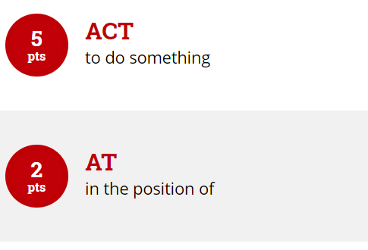
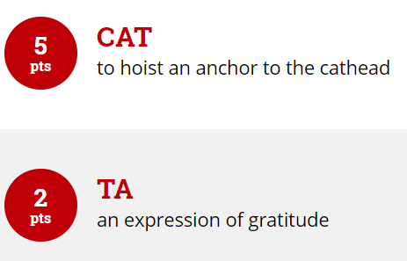
Society is like scrabble
If you have 3 letters…
You can make 4 words.

Slide 60

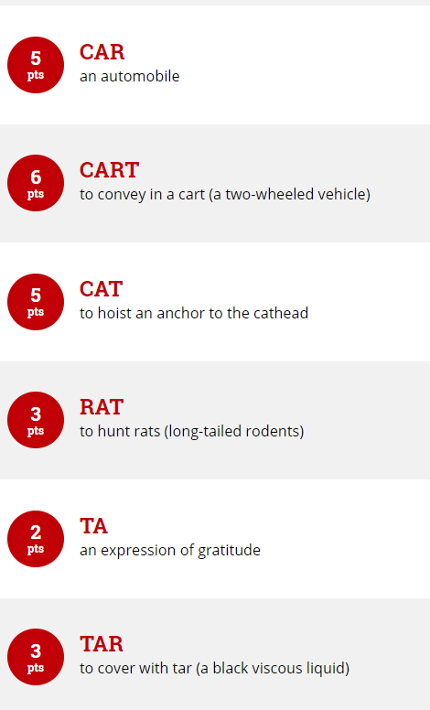
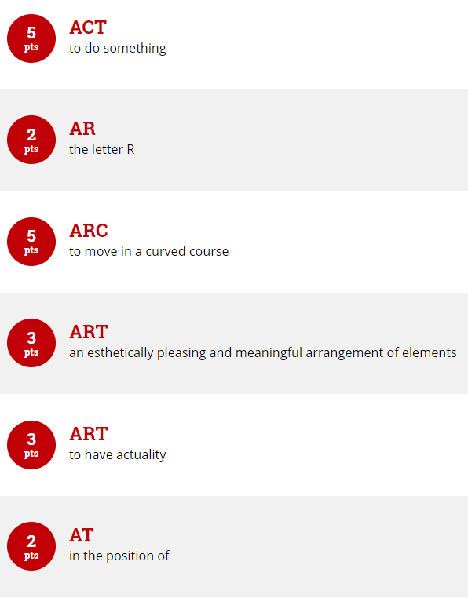
Society is like scrabble
If you have 4 letters…
You can make 12 words. And longer words.
Source: scrabble.hasbro.com

Slide 61
Society is like scrabble
If you have 4 letters… 10 letters
You can make 12 words. And longer words. 595 words
Source: scrabble.hasbro.com

Slide 62
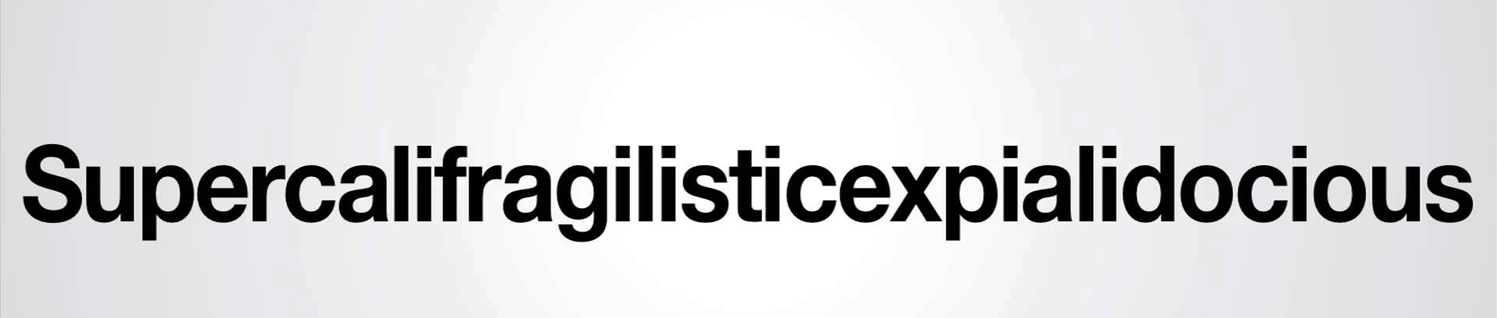
Summary - Scrabble theory
Products a society can make are like words in Scrabble
…increase the number of letters (knowhow)
  And you can make more words (products & services).
  And longer words (products & services).
  And more complex words (products & services).

Slide 63
Summary - Scrabble theory
Products a society can make are like words in Scrabble
…increase the number of letters (knowhow)
  And you can make more words (products & services).
  And longer words (products & services).
  And more complex words (products & services).

Slide 64
Summary - Scrabble theory
Products a society can make are like words in Scrabble
…increase the number of letters (knowhow)
  And you can make more words (products & services).
  And longer words (products & services).
  And more complex words (products & services).

Slide 65
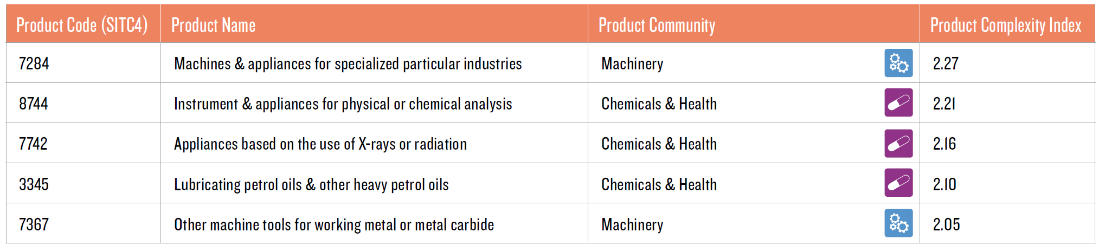
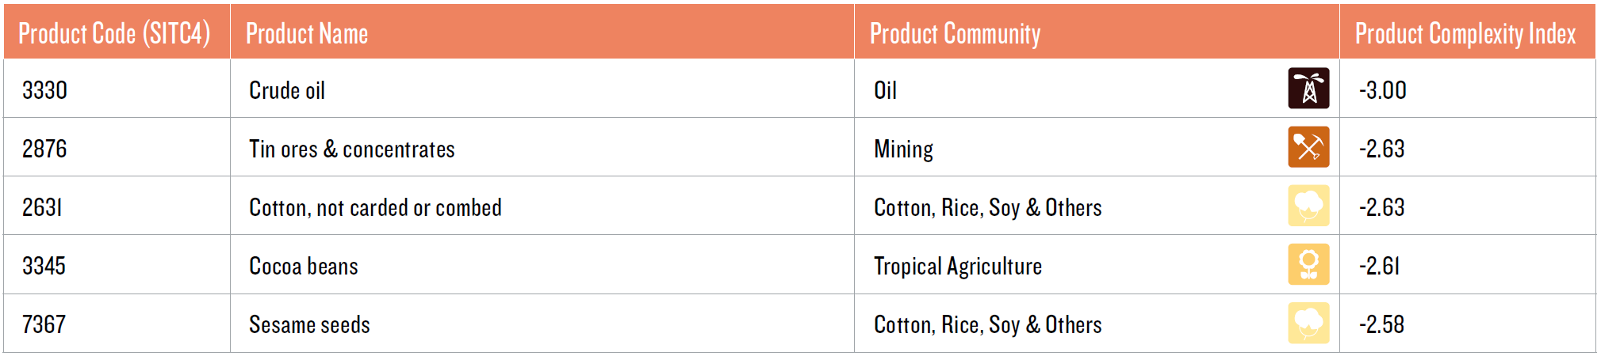
Complexity of products
Top 5 products by complexity
Bottom 5 products by complexity
Source: The Atlas of Economic Complexity, Mapping Paths to Prosperity, Harvard University. Hausmann Ricardo, Hidalgo César, et al.

Slide 66
Complexity of products
Top 5 products by complexity
Bottom 5 products by complexity
Source: The Atlas of Economic Complexity, Mapping Paths to Prosperity, Harvard University. Hausmann Ricardo, Hidalgo César, et al.

Slide 67
Complexity of products
Top 5 products by complexity
Bottom 5 products by complexity
Source: The Atlas of Economic Complexity, Mapping Paths to Prosperity, Harvard University. Hausmann Ricardo, Hidalgo César, et al.

Slide 68
Country analogy
Poor countries make few things.
That many other countries can make (non-complex products).
Rich countries make many things.
That few others countries can make (complex products).
But we want to become richer, so we need to become more complex…
How do countries acquire additional letters?
… To make more, longer and more complex words?
… How are pBs accumulated?

Slide 69
Country analogy
Poor countries make few things.
That many other countries can make (non-complex products).
Rich countries make many things.
That few others countries can make (complex products).
But we want to become richer, so we need to become more complex…
How do countries acquire additional letters?
… To make more, longer and more complex words?
… How are extra letters accumulated?

Slide 70

Chicken / egg problem

Slide 71

How to get new letters?

Slide 72

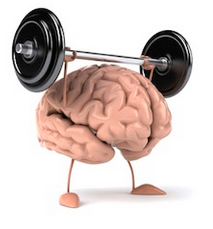

How do societies acquire knowhow?
Productive knowledge is tacit – very hard to acquire
Such knowledge resides in the brains of people.
Easier (& faster) to move brains (the person) than knowledge into brains.
As a result knowledge diffuses only slowly and across narrow channels.
Cannot download it.
Cannot send it in a container to port.
… and requires teams with complimentary skills
You need all the letters to make a word.
In a world of increasing complexity, teams become increasingly intricate.
This makes the coordination problem exponentially harder.

Slide 73
How do societies acquire knowhow?
Productive knowledge is tacit – very hard to acquire
Such knowledge resides in the brains of people.
Easier (& faster) to move brains (the person) than knowledge into brains.
As a result knowledge diffuses only slowly and across narrow channels.
Cannot download it.
Cannot send it in a container to port.
… and requires teams with complimentary skills
You need all the letters to make a word.
In a world of increasing complexity, teams become increasingly intricate.
This makes the coordination problem exponentially harder.

Slide 74
How do societies acquire knowhow?
Productive knowledge is tacit – very hard to acquire
Such knowledge resides in the brains of people.
Easier (& faster) to move brains (the person) than knowledge into brains.
As a result knowledge diffuses only slowly and across narrow channels.
Cannot download it.
Cannot send it in a container to port.
… and requires teams with complimentary skills
You need all the letters to make a word.
In a world of increasing complexity, teams become increasingly intricate.
This makes the coordination problem exponentially harder.

Slide 75
Summary
It is hard to transfer tacit knowledge. It constrains the process of growth and development. Ultimately, differences in prosperity are related to the amount of tacit knowledge that societies hold.
The complexity of an economy is related to the multiplicity of useful knowledge embedded in it.
Markets & organisations allow the knowledge that is held by few to reach many. In other words, they make us collectively wiser.

Slide 76
Summary
It is hard to transfer tacit knowledge. It constrains the process of growth and development. Ultimately, differences in prosperity are related to the amount of tacit knowledge that societies hold.
The complexity of an economy is related to the multiplicity of useful knowledge embedded in it.
Markets & organisations allow the knowledge that is held by few to reach many. In other words, they make us collectively wiser.

Slide 77
Summary
It is hard to transfer tacit knowledge. It constrains the process of growth and development. Ultimately, differences in prosperity are related to the amount of tacit knowledge that societies hold.
The complexity of an economy is related to the multiplicity of useful knowledge embedded in it.
Markets & organisations allow the knowledge that is held by few to reach many. In other words, they make us collectively wiser.

Slide 78
Summary (2)
The secret of development is technology adoption.
A major obstacle to technology adoption is the spread of collective knowhow.
Human mobility is key to accelerate technology diffusion.
Human mobility is highly constrained, especially in developing countries where it is most needed.
Recognition
Global Award for
Entrepreneurship Research.

Slide 79
Summary (2)
The secret of development is technology adoption.
A major obstacle to technology adoption is the spread of collective knowhow.
Human mobility is key to accelerate technology diffusion.
Human mobility is highly constrained, especially in developing countries where it is most needed.
Recognition
Global Award for
Entrepreneurship Research.

Slide 80
Summary (2)
The secret of development is technology adoption.
A major obstacle to technology adoption is the spread of collective knowhow.
Human mobility is key to accelerate technology diffusion.
Human mobility is highly constrained, especially in developing countries where it is most needed.
Recognition
Global Award for
Entrepreneurship Research.

Slide 81
Summary (2)
The secret of development is technology adoption.
A major obstacle to technology adoption is the spread of collective knowhow.
Human mobility is key to accelerate technology diffusion.
Human mobility is highly constrained, especially in developing countries where it is most needed.
Recognition
Global Award for
Entrepreneurship Research.

Slide 82

Economic development freebie
Many countries are paying a hefty price for
not wanting to be more open to others.

Slide 83

Policy implications
Everyone is entitled to their own opinion, but not their own facts.

Slide 84
Implications
Increased globalisation is a small open economy’s friend.
  Small domestic market in recession with a weak growth outlook.
  Look beyond our borders to larger & growing global economy.
1

Slide 85
Implications
Increased globalisation is a small open economy’s friend.
  Small domestic market in recession with a weak growth outlook.
  Look beyond our borders to larger & growing global economy.
Encourage export led GDP growth.
Without increased exports, economic growth is stifled by an increasing current account deficit.
Without export growth how to settle increased imports FX demand.
1
2

Slide 86
Implications
Increased globalisation is a small open economy’s friend.
  Small domestic market in recession with a weak growth outlook.
  Look beyond our borders to larger & growing global economy.
Encourage export led GDP growth.
Without increased exports, economic growth is stifled by an increasing current account deficit.
Without export growth how to settle increased imports FX demand.
Policy experimenting
If it was China – industrial zones to boost manufacturing - export market.
SEZs are contained experiments.
What is not working - labour, tax, market access – change it.
Continuously redirecting course. Rinse and repeat success.
1
2
3

Slide 87
Implications
SA’ problem is the industries it does not have.
Encourage more diversified skills base to allow establishment of new complex industries.
Allow skills and entrepreneurship, we don’t have, to enter the economy, to create the industries we don’t have.
Skills shortage at the top. Import them.
It will create more opportunities for jobs at the bottom.
Skilled emigrants create jobs.
Treat our diaspora better. They moved their brains to take in new tacit knowledge in other countries.
4

Slide 88
Implications
.
Focus on ownership vs entrepreneurship/know-how.
Stop the focus on the transformation of the existing industries.
Rather focus on creating new enterprises, new entrepreneurs, environment for business to create employment and new industries.
Land (ownership) without tacit knowhow will NOT deliver development.
1 factor of production (land, capital, labour, entrepreneurship) will not solve the challenge.
5

Slide 89
Contact Details
Francois Fouche
Trade Research Advisory
Innovated by the North-West University
francois.fouche@tradeadvisory.co.za
083 320 4647

Slide 90

What is GDP?
Broadest quantitative measure of a nation's total economic activity.
Monetary value of all goods and services produced within a nation's borders over a specified period of time.
GDP = Consumption Expenditure (C)
+ Investment Expenditure (I)
+ Government Expenditure (G)
+ Exports (X)
- Imports (M)
GDP = C + I + G + X - M
Calculated in: Nominal=Current i.e. with inflation in Dollars/Rands
Real=Constant i.e. without inflation in Dollars/Rands

Slide 91
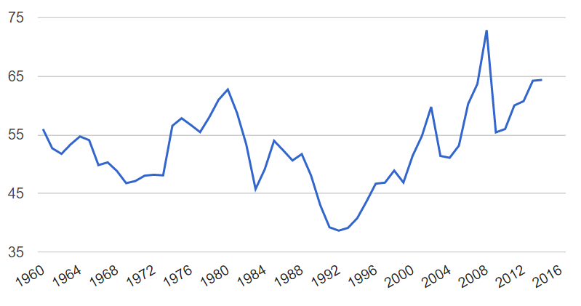
South Africa: increasing openness
(Exports & Imports) as % of GDP
Source: World Bank.

