Slide 1
South African Agriculture and Agribusiness: Prospects and Challenges
Agri North West
John Purchase
CEO: Agbiz
14 September 2018

Slide 2
For today…….
Challenging and complex environment evolving
Food Security and Competitiveness imperative
Performance of the sector
Some ag-commodity indicators
Some Agribusiness indicators
Legislative developments in 2018
Wrap up

Slide 3
Challenging and complex environment evolving
Global socio-political environment
Local socio-political environment
Consumer trends and activism – need to analyse facts, and act
Technology dynamic – 4th Industrial Revolution: Jobs dynamic NB
Climate Change – adaptation and mitigation: Weather variability?
Increased regulation of agro-food system: Food safety & health
Sustainable use of, and rights allocation to, water and land as critical natural resources – it will change: how to adapt?
Utilisation of renewable energy sources – energy security
“Trade wars are the wars of the future” – now fully with us
Big Data – mine and analyse to drive efficiency
Human capital and skills – the talent factor NB!

Slide 4
Global Socio-political Developments
Multi-polar global power dynamic – economic power shift to Asia (BRICS?)
Ambitions of China & Russia, also India & Japan: Geo-political positioning?
Middle East catastrophe – migration effect to Europe and global destabilisation
Religious fundamentalism still a factor, e.g. ISIS, Boko Haram, Al Qaeda, etc.
Brexit and European Unity: major uncertainty remains, but also opportunity
Donald Trump dynamic – USA nationalism and protectionism
Africa’s demographic ‘dividend’ and food insecurity?
Globalisation and Interconnectivity still massive driver, despite protectionist efforts.
Blockchain and Crypto-currencies – IMF CEO quote
More interconnected ➜ but greater uncertainty ➜ less control ➜
more risk ➜ greater opportunity though ➜ look for and exploit!

Slide 5
Demographics…..
Either massive opportunity,
or a critical risk……!

Slide 6
Global Socio-political Developments
Multi-polar global power dynamic – economic power shift to Asia (BRICS?)
Ambitions of China & Russia, also India & Japan: Geo-political positioning?
Middle East catastrophe – migration effect to Europe and global destabilisation
Religious fundamentalism still a factor, e.g. ISIS, Boko Haram, Al Qaeda, etc.
Brexit and European Unity: major uncertainty remains, but also opportunity
Donald Trump dynamic – USA nationalism and protectionism
Africa’s demographic ‘dividend’ and food insecurity?
Globalisation and Interconnectivity still massive driver, despite protectionist efforts.
Blockchain and Crypto-currencies – IMF CEO quote
More interconnected ➜ but greater uncertainty ➜ less control ➜
more risk ➜ greater opportunity though ➜ look for and exploit!

Slide 7
Local Socio-political Developments
ANC still in turmoil – divisions and distrust persist.
Manifested earlier in ANC loss of three major Metros, viz. Johannesburg, Tshwane and Nelson Mandela Bay, to opposition coalitions. Cape Town was already governed by DA.
DA & EFF no longer viable ruling coalitions – Realignment post 2019?
Major political uncertainty, but not necessarily all bad. Hope springs!
Biggest concern: Lack of GDP growth and Competitiveness decline (WEF)
Massive unemployment (~27%), especially amongst the Youth (>50%)
Inequality - calls for radical economic transformation (RET) will not abate.
Land & water reform will be at the centre of demands.
Crime & Security factor, including corruption and farm safety concern.
General election 2019 – political rhetoric already dominating.

Slide 8
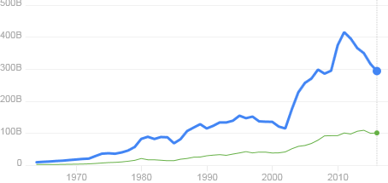
South Africa’s GDP: 294,8 billion USD (2016)
416.9 billion USD in 2011
US$
(Billion)
South Africa
Morocco
Year

Slide 10
SA Business Confidence and Fixed Investment
Source: Red Meat Levy Admin, Statistics South Africa, United States Department of Agriculture, Agbiz Research
Source: BER, SARB

Slide 11
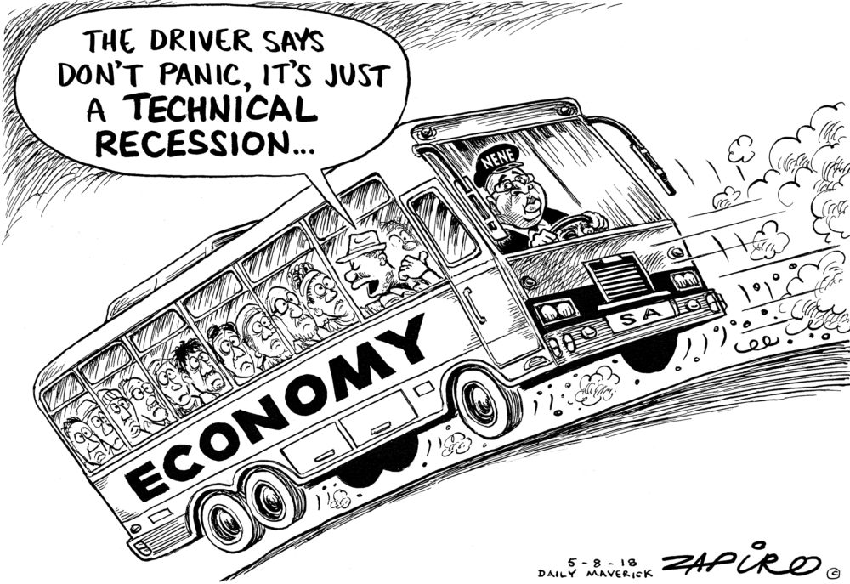

Slide 12
“Improved business confidence is the cheapest form of economic stimulus”
- Larry Summers, American economist and former Chief Economist of the World Bank.
Why is business confidence important? y.…

Slide 13
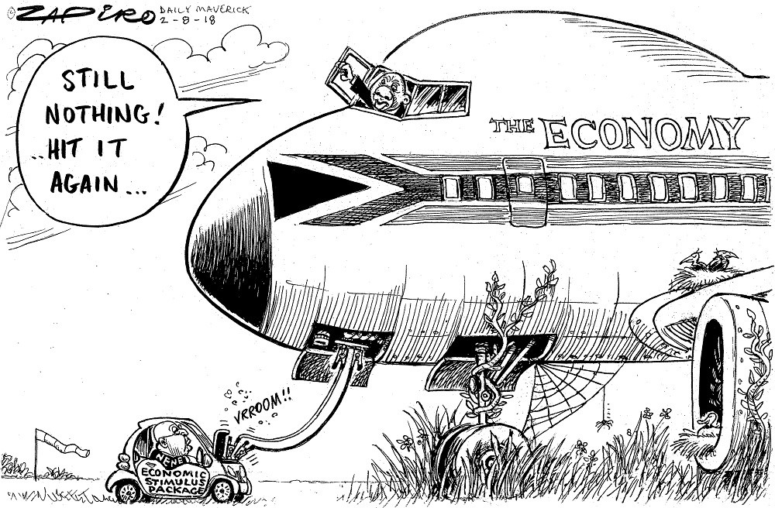

Slide 14
Local Socio-political Developments
ANC still in turmoil – divisions and distrust persist.
Manifested earlier in ANC loss of three major Metros, viz. Johannesburg, Tshwane and Nelson Mandela Bay, to opposition coalitions. Cape Town was already governed by DA.
DA & EFF no longer viable ruling coalitions – Realignment post 2019?
Major political uncertainty, but not necessarily all bad. Hope springs!
Biggest concern: Lack of GDP growth and Competitiveness decline (WEF)
Massive unemployment (~27%), especially amongst the Youth (>50%)
Inequality - calls for radical economic transformation (RET) will not abate.
Land & water reform will be at the centre of demands.
Crime & Security factor, including corruption and farm safety concern.
General election 2019 – political rhetoric already dominating.

Slide 15
For today…….
Challenging and complex environment evolving
Food Security and Competitiveness imperative
Performance of the sector
Some ag-commodity indicators
Some Agribusiness indicators
Legislative developments in 2018
Wrap up

Slide 18
Agro-food Value Chain competitiveness
Analysis on:
Relative Trade Advantage
Comparative Advantage
Competitive Advantage
Porter diamond analysis (Participative analysis)
Pioneered by Agbiz (Prof Johan van Rooyen and Dirk Esterhuizen) in early 2000’s. Still done!

Slide 19
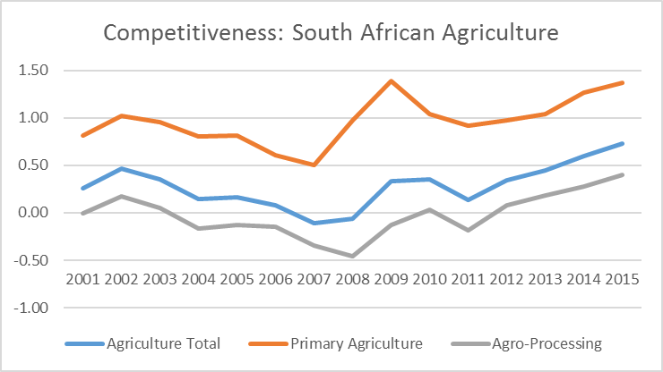
South African Agricultural Sector

Slide 20
24 of 36 commodities SA a net exporter = 67%
Source: BFAP, 2016

Slide 21
Food Security Imperative
Many definitions to food security, but the commonly used one is the FAO definition (World Food Summit 1996):
“A situation that exists when all people, at all times, have
physical and economic access to sufficient, safe and
nutritious food to meet their dietary needs and food
preferences for an active and healthy life”.

Slide 22
Components of Food Security
FOOD QUALITY & SAFETY (5)
Nutritional standards
Protein quality
Food safety, etc.
FOOD AFFORDABILITY (6)
Food consumption as % of DHI
% of pop under GPL (<$3.10)
Presence of Food Safety Net Programmes, Etc.
FOOD AVAILABILITY (8)
Sufficiency of supply
Volatility of agric production
Agricultural infrastructure
R&D spend, etc.
Food Security
Complex concept:
Difficult to measure
and evaluate.
Purchasing power
key to access
Stability over TIME

Slide 23
2017 Global Food Security Index
http://foodsecurityindex.eiu.com.
South Africa ranks 44th
SA Household Food Security a risk: ~20% of households food insecure
Source: Economist Intelligence Unit/DuPont

Slide 25
For today…….
Challenging and complex environment evolving
Food Security and Competitiveness imperative
Performance of the sector
Some ag-commodity indicators
Some Agribusiness indicators
Legislative developments in 2018
Wrap up

Slide 26
Gross Domestic Product of AFF
Source: DAFF, 2017

Slide 27
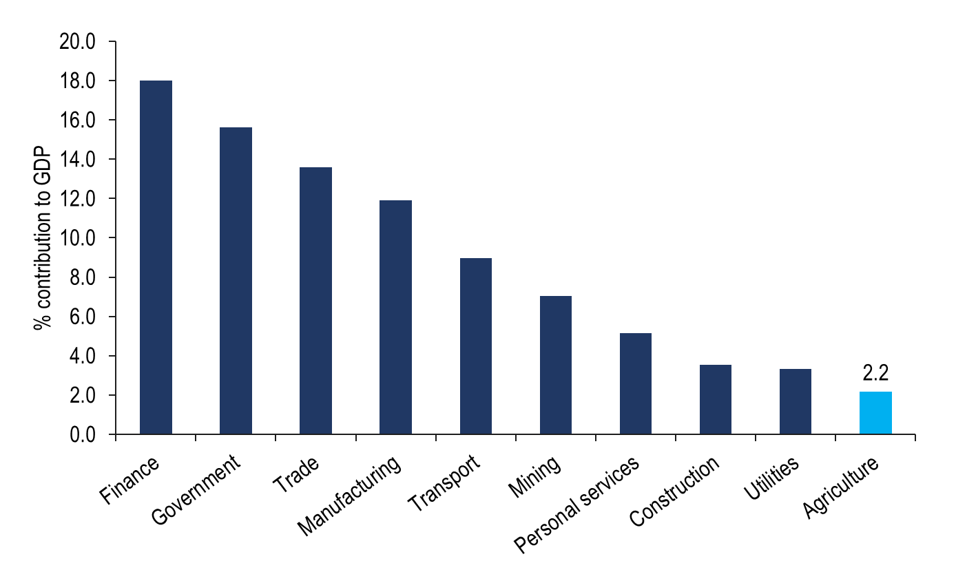
Agriculture’s share in the economy is small and has declined over time…
Source: Statistics South Africa, Agbiz Research

Slide 28
Source: Agbiz Research and Stats SA

Slide 30
Agbiz/IDC Agribusiness Confidence Index

Slide 31
Four provinces account for 80% of agricultural production over the past two decades
Share of agriculture production by province in 1995
Share of agriculture production by province in 2015
Source: Stats SA, Agbiz Research

Slide 32
For today…….
Challenging and complex environment evolving
Food Security and Competitiveness imperative
Performance of the sector
Some ag-commodity indicators
Some Agribusiness indicators
Legislative developments in 2018
Wrap up

Slide 33
Field crops
Maize – major staple, net exports, ~85% GM
Wheat – also staple food, net imports (~50% of demand)
Sorghum – declining significance
Soya – growing importance, cake imports, ~90% GM
Sunflower – stable to growing importance, S/D in balance
Canola – growing importance in Western Cape
Groundnuts – net exports, but declining
Dry beans – net imports, mostly from China
Gross value of crop production in 2016 : R57.4bn

Slide 34
South Africa’s total maize production showing good growth…
Source: CEC, SAGIS, Agbiz Research

Slide 35
SAFEX maize prices to remain pressured in the near term…
White and yellow maize prices
Source: JSE, Agbiz Research
Both white and yellow maize prices are trading along the export parity levels, as large supplies continue to keep prices under pressure.
In 2017, white and yellow maize prices averaged R2 161 per tonne and R2 097 per tonne, respectively, down by 51% y/y and 38% y/y, thanks to the record harvest.
On the 5th of September 2018, white and yellow maize spot prices settled at R2 487 and R2 545 per tonne, respectively, which is 38% and 32% higher than the corresponding period last year.

Slide 36
Horticulture
Viticulture & Wine – major export industry. Drought-hit now with 20% decline
Citrus – SA’s biggest ag-export, R19 bn in 2017, growing at ~7% pa and 2nd biggest global exporter, but CBS issue & FCM….?
Deciduous fruit – major net exports
Table grapes – major net exports
Sub-tropical fruit – net exports, and growing….
Vegetables – S/D balance, some imports/exports
Nut industries – significant growth off low base
Gross income from Horticulture (R bn)
2012 2013 2014 2015 2016
R41.8 R47.6 R53.9 R60.8 R72.6

Slide 37
Animal production
Accounts for just under half of total agriculture production : R116.73bn (2016)
Agricultural production by sub-sector
Animal production share over time
Source: DAFF, Stats SA, RMB Global Markets Research, Agbiz Research

Slide 38
Beef exports

Slide 39
For today…….
Challenging and complex environment evolving
Food Security and Competitiveness imperative
Performance of the sector
Some ag-commodity indicators
Some Agribusiness indicators
Legislative developments in 2018
Wrap up

Slide 40
SA Agricultural Trade Balance
Source: International Trade Centre, 2017
Graph: Agbiz, 2017

Slide 41
Trends in South Africa’s agricultural exports per region
Source: International Trade Centre, 2017
Graph: Agbiz, 2017

Slide 42
Risk to collateral, “expropriation without compensation”
Total agriculture farm debt
Source: DAFF, Agbiz Research

Slide 43
Capital Assets in Agriculture
Estimated value of capital assets at 30/6/2016: R421 billion
Estimated value of capital assets a year earlier: R384 billion
Indicating an increase of 9,6% from 2015 to 2016.
Total value of capital assets constituted as follows:
- Land and fixed improvements: R219 billion (52,1%)
- Livestock : R137 billion (32,7%)
- Machinery and implements: R64 billion (15,2%)

Slide 44
Agricultural employment

Slide 45
Indexed GDP: Agro-processing vs Manufacturing Output
Agro-processing: ~25% of MO and ~3.5% of GDP

Slide 46
For today…….
Challenging and complex environment evolving
Food Security and Competitiveness imperative
Performance of the sector
Some ag-commodity indicators
Some Agribusiness indicators
Legislative developments in 2018
Wrap up

Slide 47
Fields of legislation
Credit legislation: Reg. 19 (Credit bureaus) + National Credit Amendment Bill
Carbon Tax Bill: Trade exposure important. Gazetted for comment
Labour legislation: NMWB + LRAB (Nedlac package). Passed by Parliament
Competition Amendment Bill (Nedlac Report signed off)
Water rights:
- NWRS + Water Masterplan – New Water Bill & ELU
- Water licence application regulations & Water tariffs
6. Land reform:
- Expropriation without Compensation
- Regulation of Agricultural Landholdings Bill
- Draft Property Valuation Regulations (Property Valuation Act)
- Communal Land Tenure Bill
- Communal Property Association Amendment Bill
- Preservation & Development of Agricultural Land Framework Bill

Slide 48
For today…….
Challenging and complex environment evolving
Food Security and Competitiveness imperative
Performance of the sector
Some ag-commodity indicators
Some Agribusiness indicators
Legislative developments in 2018
Wrap up

Slide 49
10 Factors determining the future of Agro-food system
Consumer trends & activism
Rate and impact of technological development, and adoption
Increased regulation of agro-food system
Climate change
Water availability and cost
Sustainable and efficient use of land and water
Trade agreements/trade wars (WTO role?)
Big Data and innovation
Improved and transparent/credible communication
Skills and talent factor

Slide 50
Wrap up
Relatively healthy and robust agro-food industry: open, competitive markets driving efficiencies
Relatively technologically advanced, globally competitive sector (Rand factor)
Challenges: Investment environment, Agro-logistics, water availability and quality, environmental sustainability, R&D, crime and security, labour relations & legislation, land reform, climate change, trade agreements, sustainable transformation, etc.
Opportunities: Growing population, consumer spending trends, new markets (especially to Africa and the East), new technologies & improved productivity, etc.
Major contributor to Food Security, growth and employment in RSA.
We live in uncertain times – many risks and variables, some controllable, others not or less so. The playing field and rules of the game are changing – need to adapt.
However, risk creates opportunity, and concentrate on those risks you can manage!

Slide 51
Thank you www.agbiz.co.za

