Slide 1
GRONDHERVORMING IN 2017
Annelize Crosby

Slide 2
INHOUD
Konneksie tussen politiek en beleid;
ANC Beleidskonferensie
Gevaarligte
Wat het fout gegaan?
Huidige wetgewende en ander prosesse
Agri SA optrede
Advies aan individuele lede

Slide 3
KONNEKSIE TUSSEN POLITIEK EN BELEID
Politiek en beleid wat gewoonlik later uitdrukking vind in wetgewing, was nog altyd nou verbonde aan mekaar;
In ‘n lesing wat ene Michael Hash in 2008 in Washington gelewer het met die tema : Ïntersection between policy and politics” het hy die volgende gesê: “I think it’s useful to begin our discussion by dispelling some of common myths about policy making and politics. First and foremost, they are inextricably intertwined. Certainly, the most successful public policies are those that have been informed by political judgments. That’s another way of saying policies need to meet specific political needs and values.”
Dit is in die VSA gesondheidsorg konteks gesê, maar is nog meer relevant in die huidige SA grondhervormingskonteks.

Slide 4
KONNEKSIE TUSSEN POLITIEK EN BELEID
‘n Nigeriër met die naam van Taiwo Makinde skryf in ‘n 2015 artikel met die titel: “Interf ace between Politics and Public Policy: A Relationship of Inseparableness” sê onder andere dat politiek nie geskei kan word van staatsadministrasie nie en hy maak die punt dat: “There is an interface between politics and public policy at every stage of policy process, thereby reflecting a close relationship between the two that makes it rather difficult to separate one from the other.”

Slide 5
KONNEKSIE TUSSEN POLITIEK EN BELEID
In SA, as gevolg van ons geskiedenis is die band tussen politiek en beleid oor grond baie sterk en soos wat die regerende party se steun taan, word dit al hoe sterker.
Die grondkwessie het ongelukkig nou ‘n politieke speelbal in SA geword;
Carol Paton, die adjunk-redakteur van Business Day skryf op 27 Junie 2017 die volgende in ‘n artikel getiteld: “Tough times ahead as ANC policies will slow the economy” : “Policy positions are proxies for leadership battles. We can expect policies on land and on the Reserve Bank, in particular, to be markers of support for Nkosazana Dlamini-Zuma and Cyril Ramaphosa. Should the Zuma group prevail in numbers, which is widely expected, the resolution on the economy will contain several investor-unfriendly clauses including expropriation without compensation, support for the Mining Charter and possibly something on the nationalisation of the Reserve Bank.”

Slide 6
ANC BELEIDSKONFERENSIE
Die ANC se middel van die jaar beleidskonferensie het plaasgevind vanaf 30 Junie tot 5 Julie 2017. Die groot beleidskonferensie vind in Desember 2017 plaas;
Konsep-beleidsdokumente wat tydens die beleidskonferensie bespreek sal word, is reeds in Maart 2017 vrygestel.
Die besprekingsdokument oor ekonomiese transformasie, waarin daar onder andere met grondhervorming gehandel word, swyg oor onteiening sonder vergoeding en sê ook niks oor die skrapping of wysiging van die eiendomsklousule nie.
Die aanbeveling wat in die konsep ANC beleidsdokument vervat is, is die volgende:

Slide 7
ANC BELEIDSKONFERENSIE
ANC policy commits government to returning land to our people and due to this commitment South Africa’s Constitution mandates that land reform must take place.
The Constitution’s commitment to ‘just and equitable’ compensation for the acquisition of land for land reform purposes should be codified and should replacement for market-based valuations of land.
The process must be facilitated and accelerated by the passing of updated expropriation legislation by Parliament.
Government should take heed of the Constitutional Court’s finding that agreement on the quantum of fair compensation is not a pre-condition for land redistribution to take place and should never pay a premium in purchasing land for the purpose of land reform/
reform.

Slide 8
ANC BELEIDSKONFERENSIE
Substantial investment in irrigation infrastructure is required, as is the resolving of water rights and the control over the allocation of water rights, and as is greater investment in innovative market linkages for small-scale farmers in communal and land reform areas.
Furthermore, institutional capacity needs to be improved with regards to accurate record keeping and the removal of uncertainties with regard to the roles of various overlapping public sector bodies involved in land reform.”
Enoch Godongwana, die voorsitter van die ANC subkomitee wat ekonomiese transformasie gaan bespreek, het op 17 Maart 2017 die volgende gesê in ‘n Mail and Gaurdian artikel: “

Slide 9
ANC BELEIDSKONFERENSIE
“The barrier to effective land reform is a lack of political will and not the Constitution, says ANC economic transformation head Enoch Godongwana. He dismissed as rhetoric the growing calls by some ANC leaders, including President Jacob Zuma, for radical economic transformation, which includes expropriation of land without compensation. The Zuma grouping views white monopoly capital as the main enemy to economic transformation. But an alternative view proposed by the party’s subcommittee moves away from the rhetoric of white monopoly capital and instead focuses on corruption in government as a barrier to economic transformation.”

Slide 10
ANC BELEIDSKONFERENSIE
Die dag na die beleidskonferensie het die Huffington Post die debat oor grond soos volg opgesom: “It seems opposing factions battled to reach consensus on land seizures and mine ownership. No clear recommendations were submitted but the party is contesting whether or not legislation needs to change to allow for the expropriation of land without compensation, or whether the Constitution is adequate to go on in carrying out land reform.”
Prof Dirk Kotze het op 6 Julie 2017 as volg geskryf in die City Press:” The National Policy Conference hasn’t recommended significant policy changes. The leadership changes in December 2017 might herald new policies. But this policy conference doesn’t provide South Africans with any basis of what might be possible. It has been too preoccupied with leadership succession. “

Slide 11
ANC BELEIDSKONFERENSIE
Dirk Kotze maak ook ander interessante gevolgtrekkings in sy nabetragting in City Press oor die Julie beleidskonferensie: Hy sê onder andere: “as one analyses the essence of the 2017 policy conference the focus is no longer primarily on policy. Rather it’s on policy as a means towards a political end – succession.”
The main shortcomings in the ANC’s approach to policy are twofold.
The first is that it concentrates almost exclusively on policy objectives but very little on policy strategies: how to achieve them; how to manage and coordinate policies. Government officials are often without a policy roadmap.

Slide 12
ANC BELEIDSKONFERENSIE
The second is that the ANC’s historical legacy places on limits its policy imagination. “Colonialism of a special type” is still the point of departure of the latest strategy and tactics document. A neo-colonial form of it is contemplated but even this makes exploration of options beyond its confines very difficult. At the same time socio-economic conditions in South Africa are changing radically. This includes urbanisation and the growth of the black middle class.

Slide 13
GEVAARLIGTE
Die grondhervormings-scenarios wat in 2015 deur Vumelana Development Fund en Reos-partners ontwikkel is, dui daarop dat arm mense hulle Geduld begin verloor met die stadige vordering met grondhervorming en dat ‘n elite-groepering besig is om grondhervorming tot ‘n redelike mate te kaap. Die scenarios wys daarop dat grootskaalse grondbesetting, radikale wetgewing en beleid en voedselonsekerheid waarskynlike uitkoomste in Suid-Afrika is as die kwessie nie dringend aangespreek word nie;
Haatspraak teen grondeienaars is besig om toe te neem en onverantwoordelike uitlatings word deur politici en opportuniste gemaak.
Dreigemente van die wysigings of skrapping van artikel 25 van die Grondwet moet ook nie ligtelik opgeneem word nie.

Slide 14
Wat het fout gegaan?

Slide 15
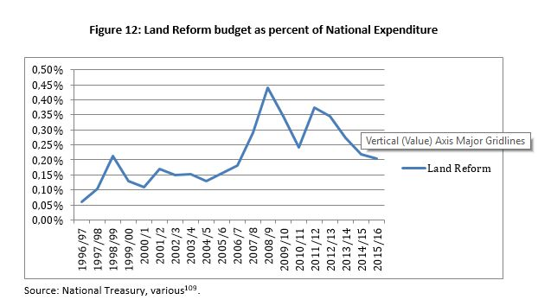
Wat het fout gegaan – te min geld begroot

Slide 16
Wat het fout gegaan – skewe spandering?

Slide 17
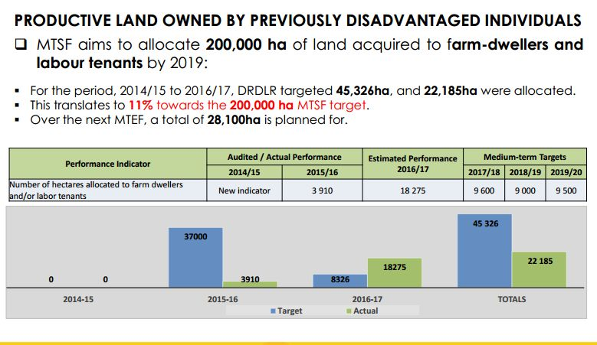
Wat het fout gegaan – teikens word nie bereik nie

Slide 18
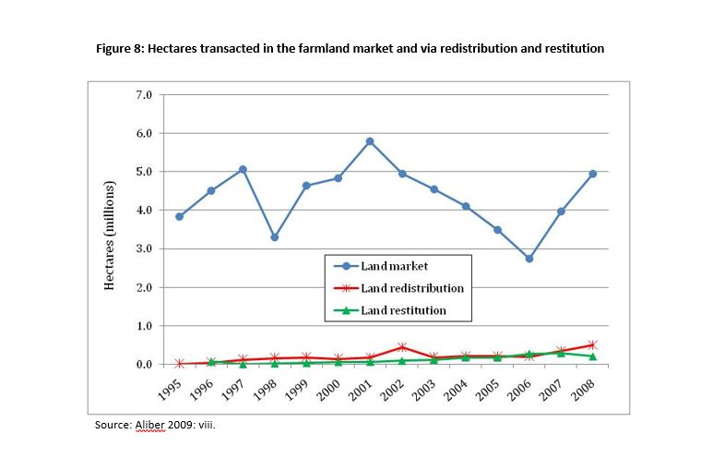
Wat het fout gegaan – oneffektiewe meganismes van grondoordrag

Slide 19
HUIDIGE WETGEWENDE EN ANDER PROSESSE
Wetsontwerp op die Regulering van Grondbesit – kommentaartydperk verby – NEDLAC? – Parlement – ongrondwetlik en onprakties – wyd gekritiseer;
Regulasies in terme van Wet op Eiendomswaardering – kommentaar tydperk verby, maar Waardeerder-Generaal konsulteer nog met Agri SA – 4 werkswinkels – insette sal nog in ag geneem word;
Grootste bron van kommer – “current use value” en acquisition benefits” netto inkomste plus markwaarde gedeel deur twee minus ander aftrekkings.
Agri SA kommentaar – litigasie?
Onteieningswetsontwerp – terugverwys – moet fyn dopgehou word.

Slide 20
AGRI SA OPTREDE
Ons moet baie strategies met hierdie uiters sensitiewe kwessie omgaan – kan nie alle aksies openbaar nie;
Moet die openbare mening swaai en realisme bring - kommunikasieveldtog;
Grondoudit – ooreenkoms met ADS en Landbou Weekblad;
Kommentaar, beinvloeding, vennote;
Uitrol van 2014 kongresbesluite – finansieringsplan, ideebank/ projek konsepte, volhoubare restitusie, NOP, sosiale pakt,
Litigasie: Msiza-saak oor regverdigige en billike vergoeding, Regulering van Grondbesit?; Regulasies oor waardasie?
.

Slide 21
ADVIES AAN INDIVIDUELE LEDE
Kies jou organisasie versigtig en gee dit jou volle steun;
Moenie van stryk gebring word deur politiekery, bangmaak-praatjies en halwe-waarhede nie;
Wees ingelig;
Wees pro-aktief;
Bou verhoudings op alle vlakke.

Slide 22
SLOTSOM

Slide 23
DANKIE!!

