Slide 1

Agricultural Outlook 2017 -
Catching up on global cycles
Agri-NW Young farmer conference
Ferdi Meyer
Bureau for Food and Agricultural Policy (BFAP)
University of Pretoria
20 April 2017

Slide 2

The pendulum
Due to biological nature of production, the pendulum effect is by far the biggest in agriculture
SOME WE CAN MEASURE ……..SOME WE CAN’T

Slide 3
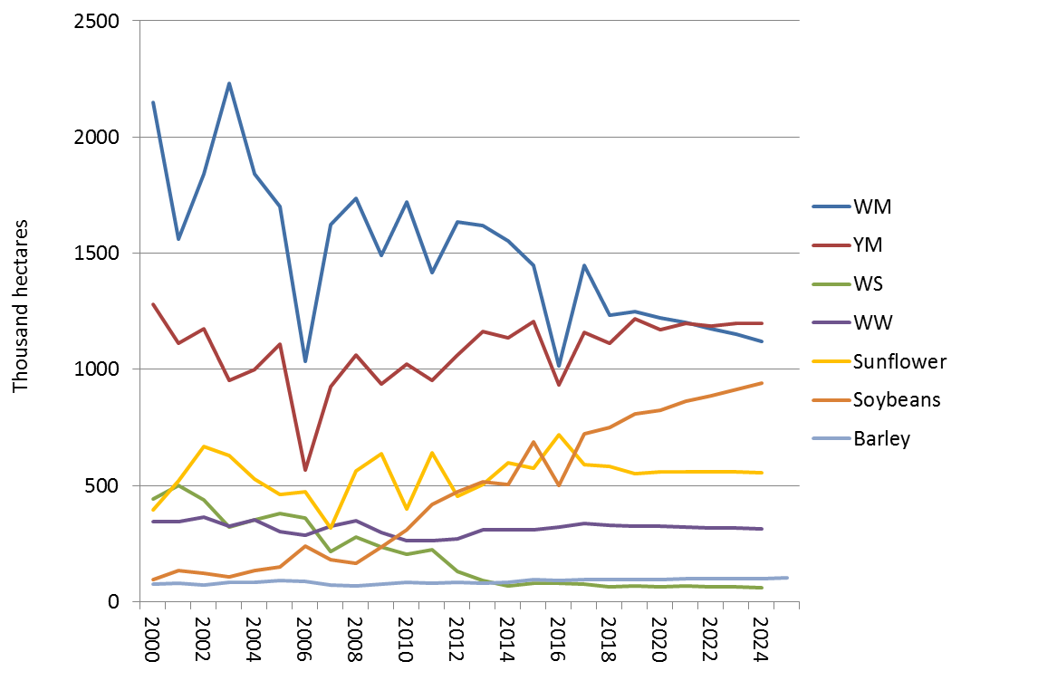
Relative shift in area

Slide 4
El Nino (2015/16) & La Nina (2016/17)
Source: ReNAPRI, 2017
Notes:
KEY POINTS:
Major shifts in rainfall patterns resulting in region surpluses and shortfalls
Significant opportunity for intraregional trade.

Slide 5
Global grain prices

Slide 6
Exchange rate

Slide 7
Pendulum in the grain market

Slide 8
Regional revenue: Grain & oilseeds
FS revenue increase by almost 50% followed by NW (17%)
A noteworthy decline is projected for NC, KZN, MP, LP & GP
Notes:
Could hide this one..

Slide 9
Drought impact: Beef
Source: University of the Free State and RPO
Fig 71 & 72,
Pg. 81-82
Notes:
As was clear from the previous slide, the impact of the drought was particularly severe in the beef sector, where pasture conditions are an important factor. Compared to field crops and even other livestock sectors, the effects also linger much longer..
This slide shows results from a survey conducted by the UFS for the RPO – its an index of herd numbers between 2013 and 2016.. On the left, we have the national cow herd, as well as the 4 main provinces which between them account for more than 70% of the total beef herd.. Its clear that the worst of the decline comes from the North west and the Free State, where the drought conditions were particularly bad..
On the right, we have a breakdown of the national numbers, where the strategy followed by most producers was to slaughter older cows first and retain young heifers to preserve productivity. Whilst the cow herd was reduced by as much as 15%, the decline in replacement heifer numbers is far less severe..
Looking ahead, one of the greatest uncertainties is the extent to which grazing conditions will recover – the decision to retain young heifers will be good for productivity, but an extended period of poorer grazing conditions will counteract that..

Slide 10
Export success for the beef industry
Fig 73, pg. 83
Notes:
In a situation where we see such drastic herd reductions, you would expect prices to fall due to oversupply in the market – which has typically been the case through previous drought periods.. This expectation would further be enhanced by the fact that South African consumers are under increasing financial pressure and domestic demand is weak as a result..
But in reality we have seen prices hold up fairly well through the drought – largely as a result of firm demand in the export market. The chart shows growth in South African beef exports from 2013 through to the end of 2015. The initial growth was mainly in beef eat and processed products, but its important to note that the world health organisation declared South Africa free of Foot and Mouth Disease in 2014 – after which frozen cut exports started to increase dramatically – tis is highlighted by the yellow bars in the chart, in value terms.. The period after obtaining free of FMD status is shaded..
Nico, what all is included in the blue “beef meat and processed”? This section also expanded strongly – where to? Also, which cuts are going to which countries?
Meat prices did increase over this period, but the increase in trade was not only in value terms, its also very clearly evident in the black line, which indicates export volume.. From the 4th quarter of 2012 to the 4th quarter of 2015, export volumes increased almost 6 fold..

Slide 11
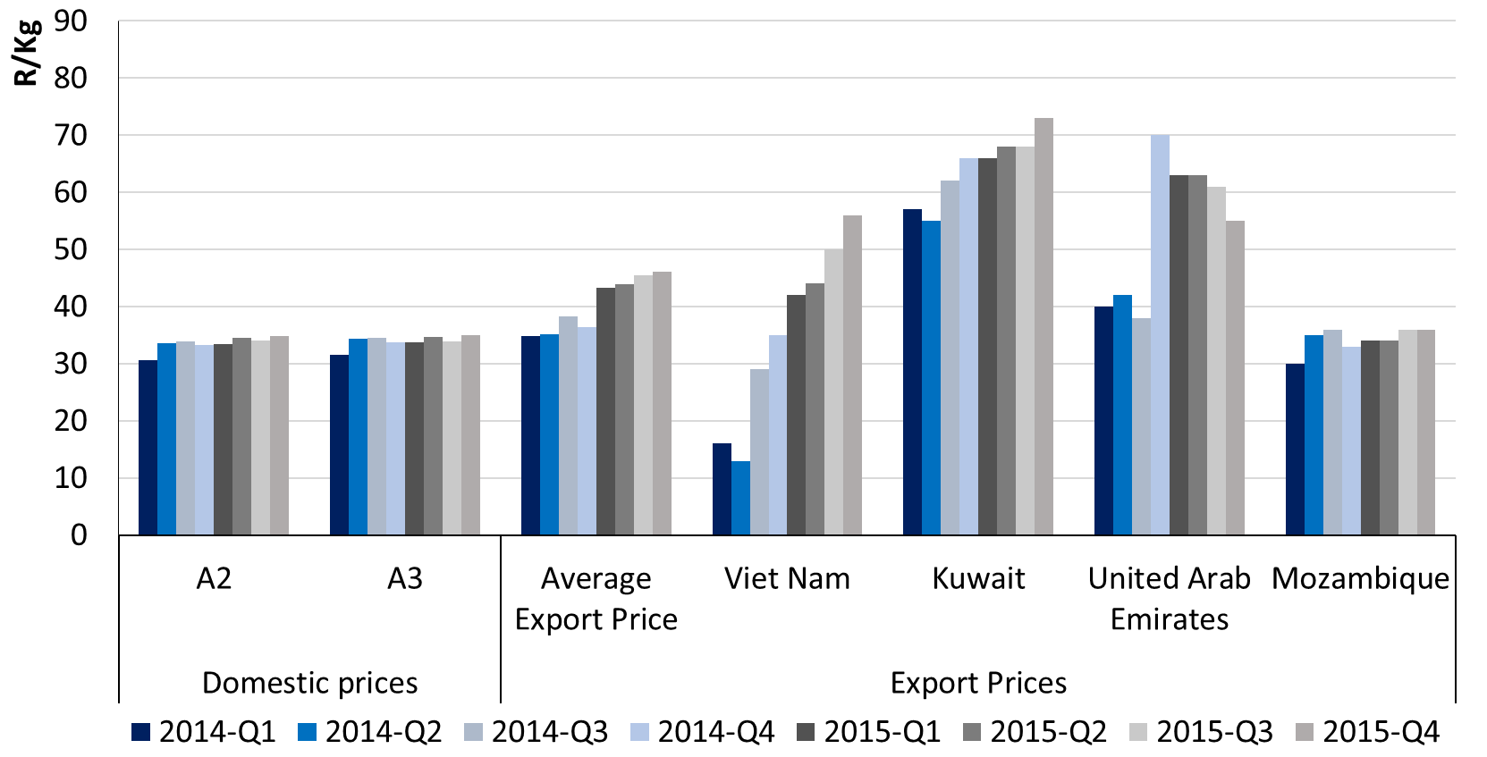
Export prices
Notes:
What is encouraging about these beef exports is also the price – particularly in growing middle eastern markets, high value cuts are being exported at good prices, allowing producers to optimise the value of a carcass.
The chart compares A2 and A3 carcass prices in South Africa quarterly in 2014 and 2015 to the unit values of exported products destined for specific destinations.. Vietnam started as a fairly low value market, which increased rapidly over time, but to Kuwait and UAE for example, prices are well above domestic carcass price levels, whereas SADC exports to neighbouring Mozambique match the values obtained in the domestic market..
The average export price has increased steadily over time – to a large extent due to the weakening exchange rate..

Slide 12
Beef Outlook
Fig 75, pg. 85
Notes:
Looking at the longer term view for the beef market then, its pretty positive, despite the extended drought impact over the next few years. Prices are expected to increase sharply in the short term, as supply tightens following herd reductions – export demand is unlikely to go away..
Given trying economic conditions, combined with the supply reductions and weak currency, domestic demand declined sharply in the short term, before recovering somewhat in the 2nd half of the outlook. Following the sharp increase in 2016 & 2017, prices flatten off through 2018 and 2019 as supply starts to pick up again. Through this period, international prices also decline. Over the 2nd half of the outlook, prices climb again in nominal terms and remaining fairly flat in real terms.. The rise in export demand have shifted prices to a new level though, from which they are not expected to decline..
Although a reduction is expected in 2017 as supply reduces, exports still remain at a new higher level through the outlook relative to the past, supporting prices on a higher base. By the end of the projection period, South Africa is expected to be a net exporter of beef, having been a net importer historically. Thus following the initial recovery period after the drought, the industry has exciting growth opportunities..
Mention past drought cycles

Slide 13
International meat prices
Notes:
Here we compare the meat to maize price ratio in South Africa – the solid lines, and the US – the dotted lines, for beef in blue and chicken in yellow.. The ration presents a simple profitability indicator and shows that in 2015 and 2016, What we see from the figure is that in both industries, profitability in South Africa declined relative to the US during the drought seasons, but given the sharp increase in beef prices, it restores much closer to the US values over the outlook than what chicken does.. Historically, beef has also been significantly above the US values at times..

Slide 14
International Competitiveness
Notes:
Here we compare the meat to maize price ratio in South Africa – the solid lines, and the US – the dotted lines, for beef in blue and chicken in yellow.. The ration presents a simple profitability indicator and shows that in 2015 and 2016, What we see from the figure is that in both industries, profitability in South Africa declined relative to the US during the drought seasons, but given the sharp increase in beef prices, it restores much closer to the US values over the outlook than what chicken does.. Historically, beef has also been significantly above the US values at times..

Slide 15

Real agricultural prices declining
Notes:
The developments in supply and demand are embodied in prices
Very long price series, expressed in real terms, show the long term decline in basic food prices which has helped to improve the availability of food and reduce the proportion of food expenses to total incomes.
It was possible through consistent improvements to technology lowering the costs and allowing a production expansion despite lower prices.
The spike of the last decade was certainly severe, but not unprecedented… the big concern over high prices was their link to other global concerns such as climate change and energy markets which threatened to affect food availability….. The question was “ Is the decline in long term food prices over?”
IFPRI projections saw an end to these efficiency gains, new paradigm where resource cost were constantly rising, time of oil at 150$
Prices are projected to be at or near longer term real trend levels over the next decade.
Combining growth in production per person, and longer term price declines, and its response to bring high prices back to trend levels, suggests that global agriculture is resilient to the challenges it faces...
Of course, performance does vary by country/region, and future challenges, such as water availability and climate change may be much more difficult in the future.

Slide 16
Per-capita use of grains and oilseeds
Source: Author calculations based on June 2016 USDA PSD Online data for 9 grains and 5 oilseeds and U.S. Census Bureau population estimates
Notes:
After more that 20 years of remarkable stability, per-capita use of grains and oilseeds began to increase rapidly in 2004. However, just two factors: the growth in Chinese demand (mostly for feed) and in U.S. ethanol production from maize, account for almost all of the increase. After taking out China and U.S. maize for ethanol, per-capita use of grains and oilseeds is almost exactly the same now as it was in 1980.

Slide 17
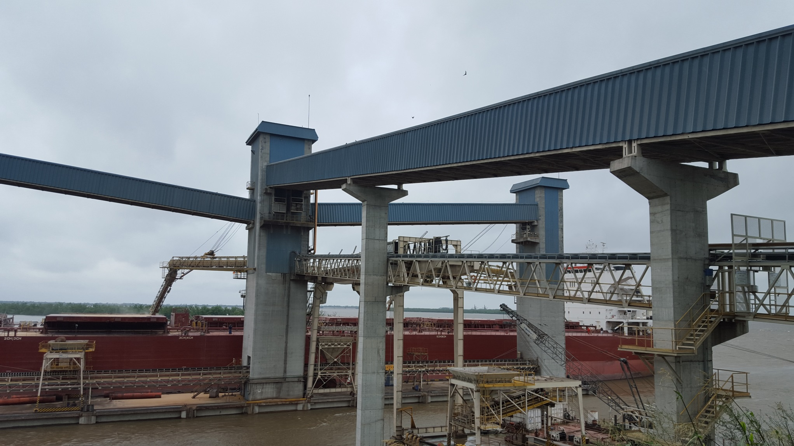
Low margins – high volumes

Slide 18
Production cost comparison
Source: Agribenchmark
Figure 13.7, Pg. 115

Slide 19
Representative farms
Source: FAPRI, 2016
IA
NE
IN
MON
MOC
TXNP
TN
TXP
SC
TXW
TXU
Notes:
Could hide this one..

Slide 20
US farm profitability: average per acre: 2016-2020
Net profits in high input farms under severe pressure & in many cases negative for 2016-2020.
 | % of land owned | Receipts | Operating Expenses | Other Expenses | Net Return | Net Return in Rands per hectare
Indiana | 32% | $ 636 | $ 462 | $ 157 | $ 17 | R546
Missouri | 50% | $ 657 | $ 378 | $ 180 | $ 99 | R3 178
Iowa | 25% | $ 643 | $ 574 | $ 87 | $ -18 | - R578
Nebraska | 25% | $ 864 | $ 724 | $ 191 | $ -51 | - R1 637
Texas | 20% | $ 624 | $ 496 | $ 82 | $ 46 | R1 477
Tennessee | 20% | $ 503 | $ 390 | $ 121 | $ -8 | - R257
South Carolina | 40% | $ 675 | $ 559 | $ 120 | $ -4 | - R128
Average |  | $ 657 | $ 512 | $ 134 | $ 12 | R371
Source: FAPRI, 2016
Notes:
Could hide this one..

Slide 21
Soybean – Maize Ratio
Soybeans = US Nr 1 Central Illinois, Maize = US Nr 2 yellow Gulf

Slide 22
Regional Maize balance
Source: ReNAPRI

Slide 23

The Road from DAR to Lusaka

Slide 24
Agriculture within a broader context

Slide 25
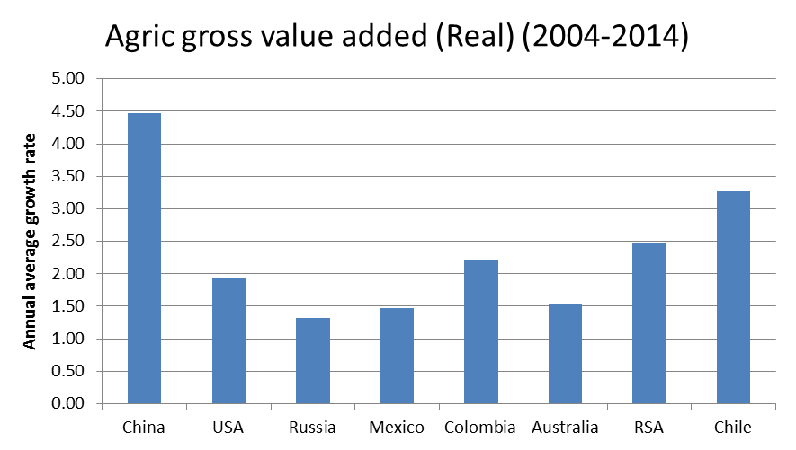
Agricultural growth

Slide 26
Subsector contributions
Source: DAFF & BFAP, 2016

Slide 27
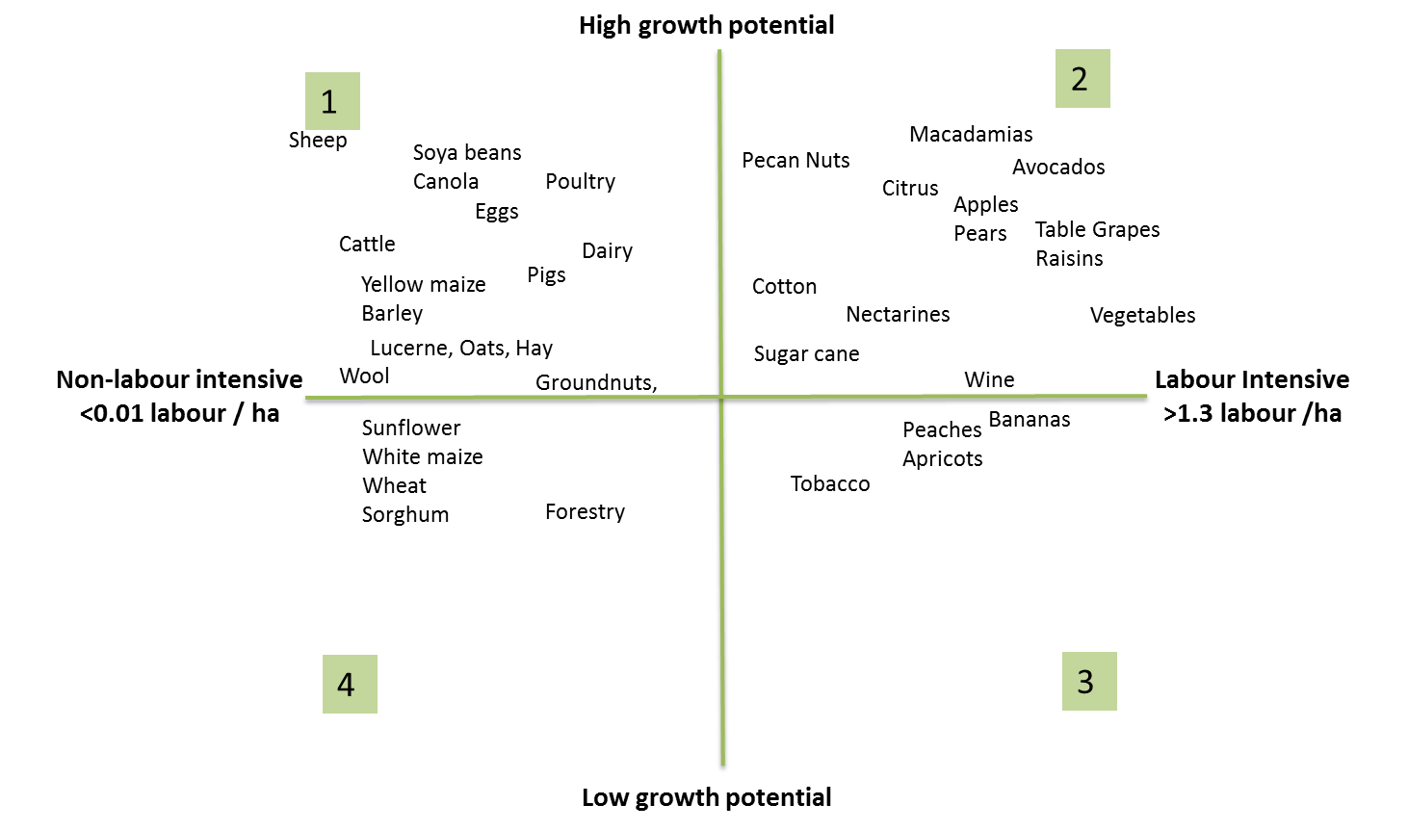
Where should we focus?
Update on NDP Employment & Investment 2030 Matrix

Slide 28
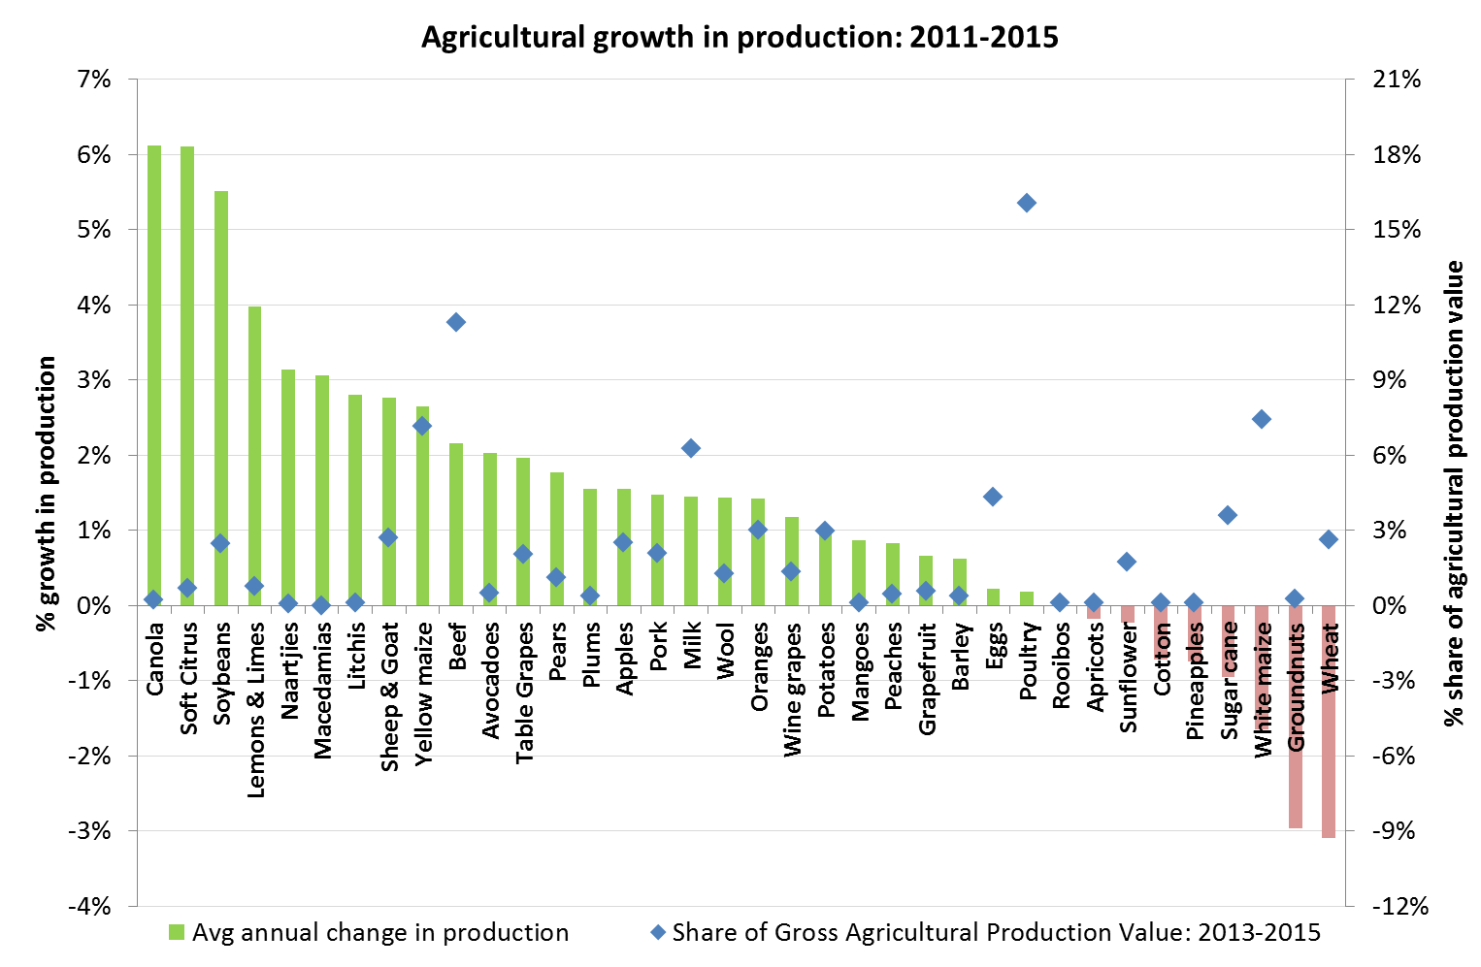
Agricultural production growth: 2011-2015
Total growth over past 4 years = 7.6% on average across industries
Mixed results & overall growth not fast enough – more can be done!

Slide 29
SA agricultural net exports
BREXIT?
Notes:
Trade opportunities by market
SA is largely a net exporter to the African continent, and that is increasing.
But a net importer when compared with South and North America.
While we are a net exporter to EU, that trade is flattening now.
The impact of Brexit is yet to playout.
Trade agreements play an important role. Recently the TFTA was signed, while the EU-SA EPA was recently signed and will soon be ratified by the SA parliament. The entry date of SA-EU EPA is set for 1 October, from then on TDCA will cease to exists.

Slide 30
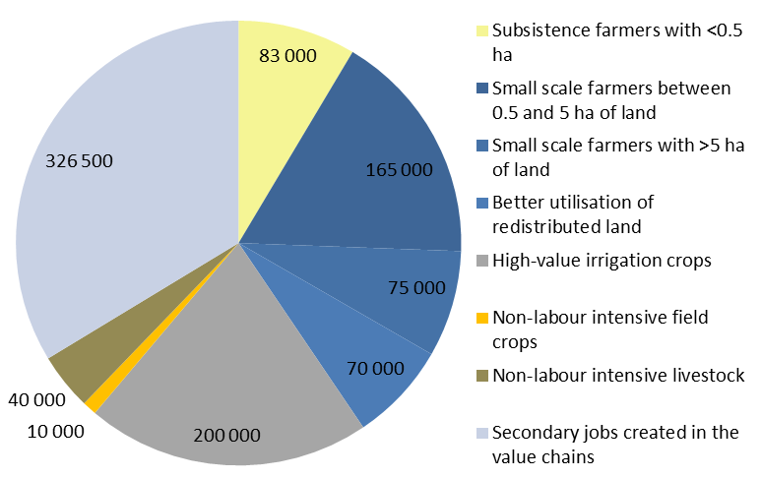

NDP vision – focus on jobs & growth
Figure 10: The million jobs
Source: NPC, 2012

Slide 31
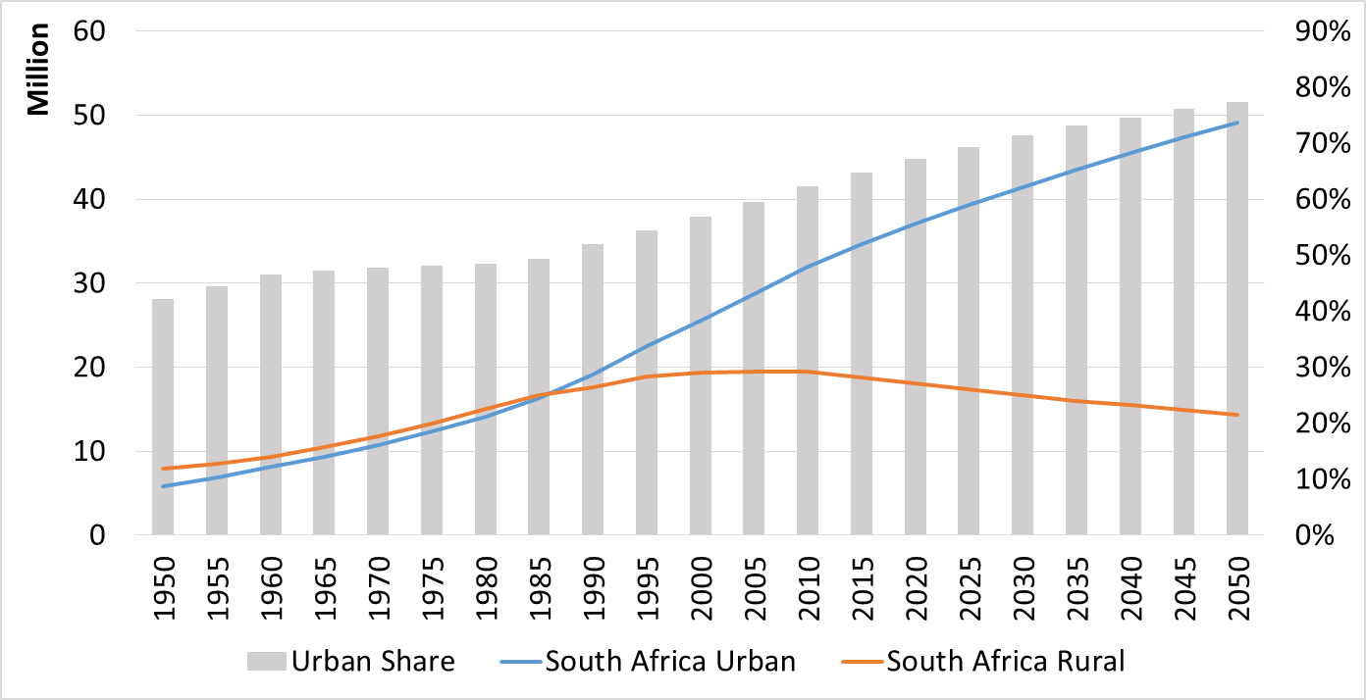
SA challenge: Urbanization & rural unemployment
Source: United Nations, 2016

Slide 32
End!
Visit us at
www.bfap.co.za

